Slide 1
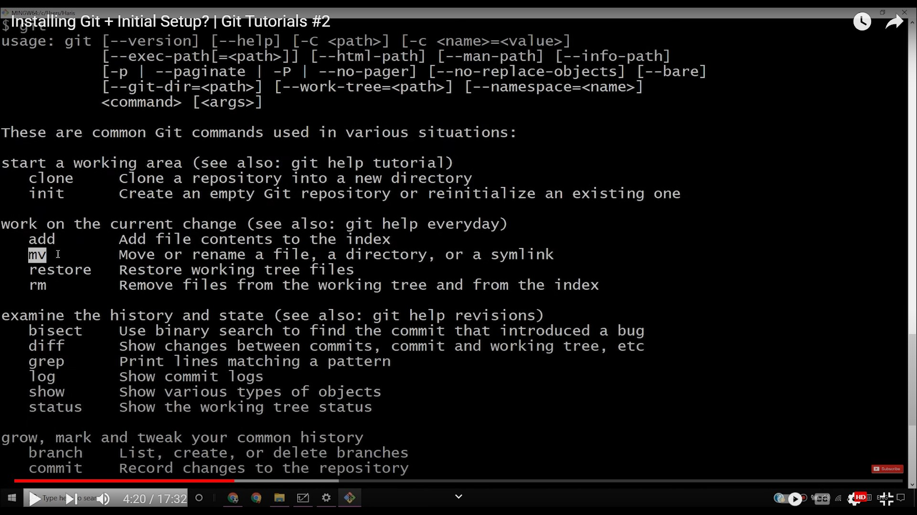

Slide 2
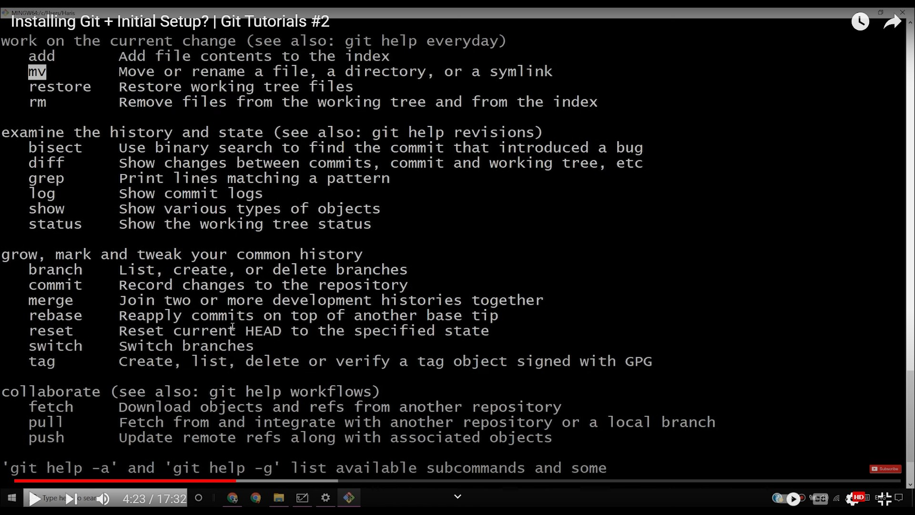

Slide 3
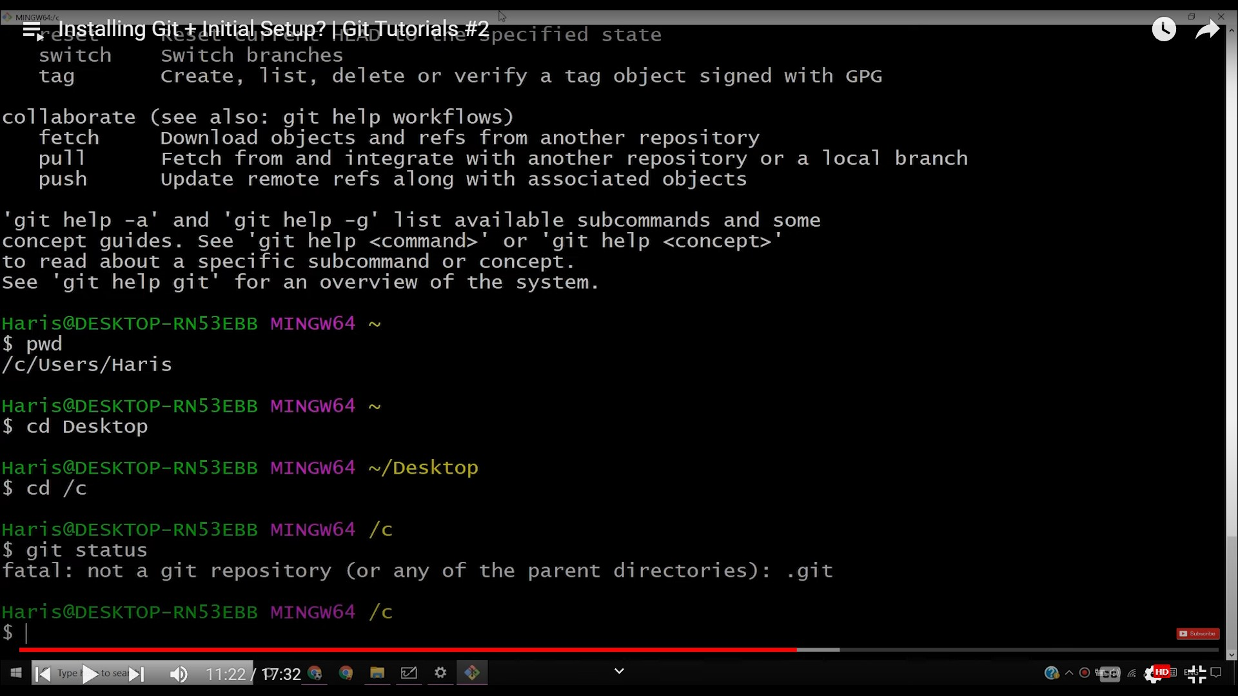

Slide 4
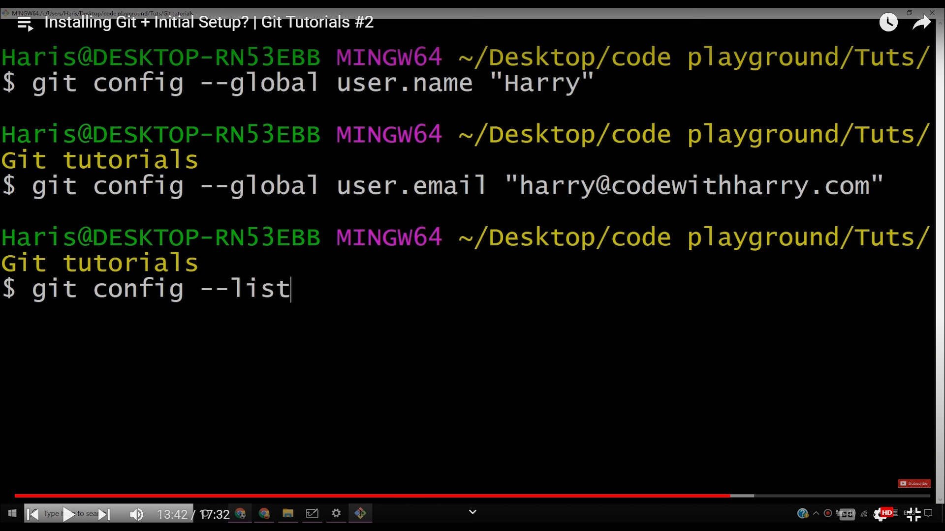

Slide 5
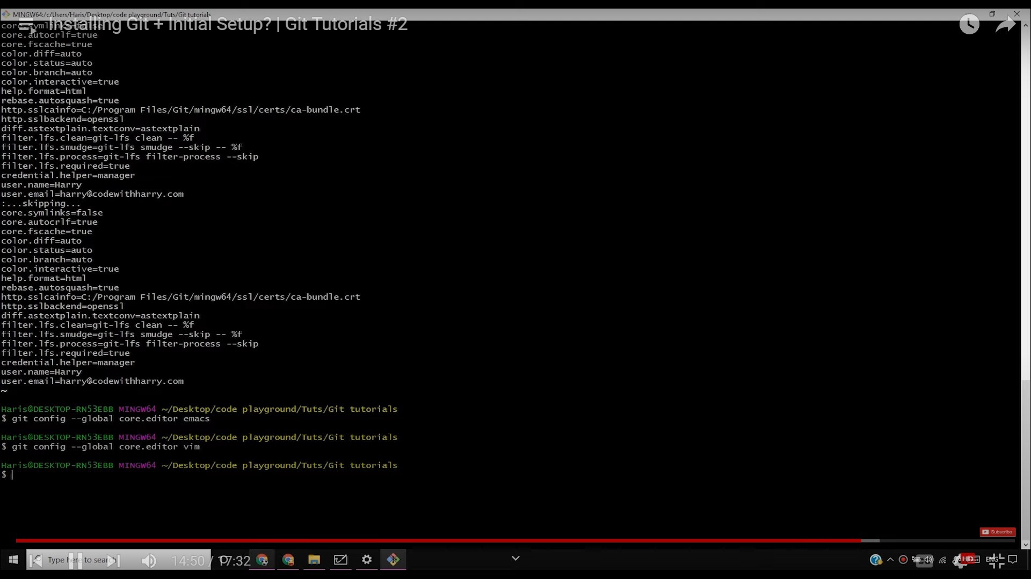

Slide 6
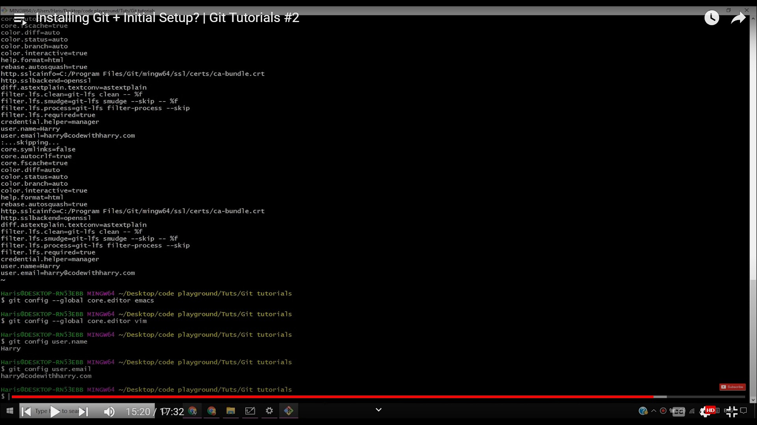

Slide 7
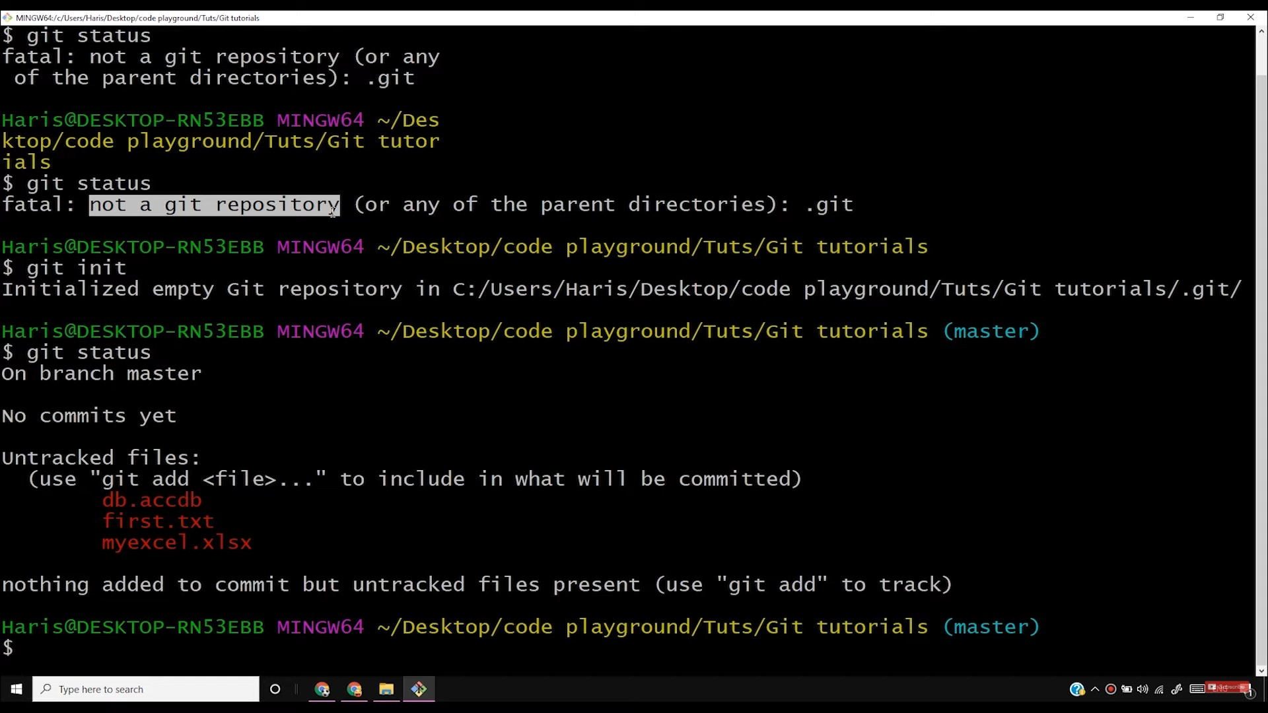

Slide 8
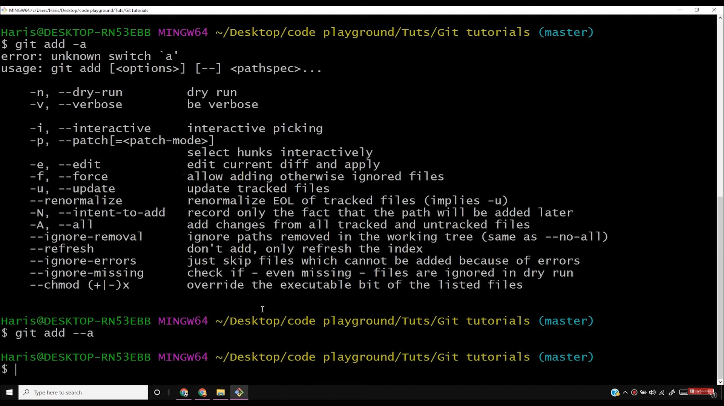

Slide 9
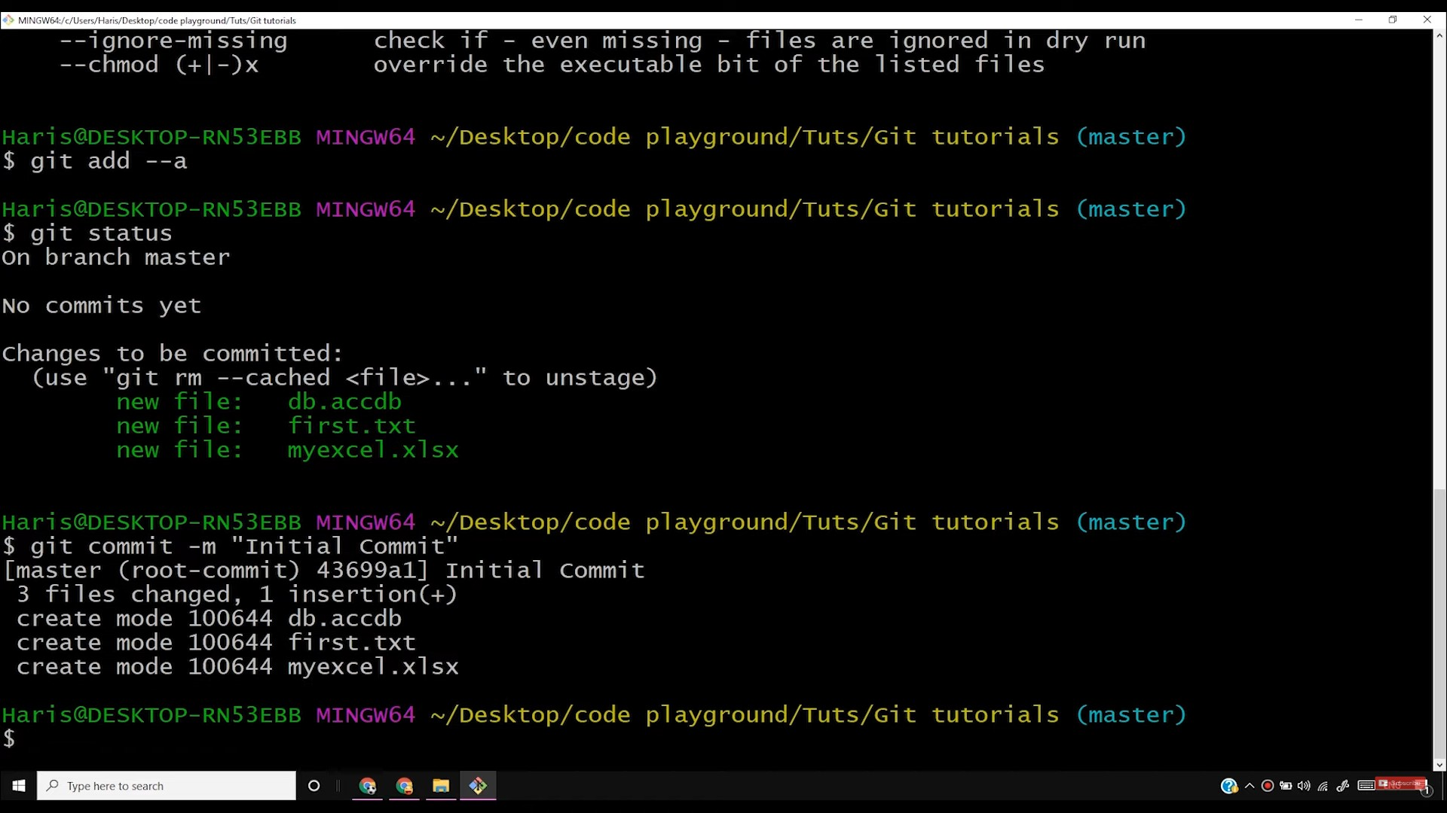

Slide 10
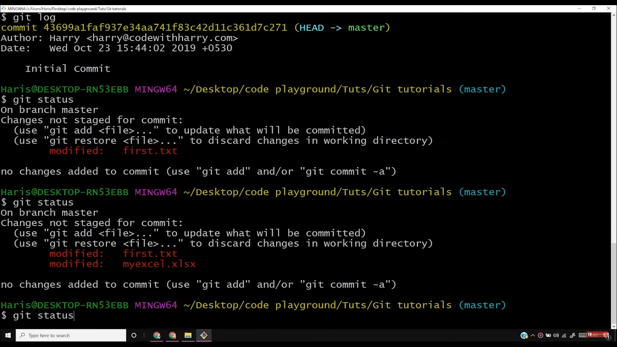

Slide 11
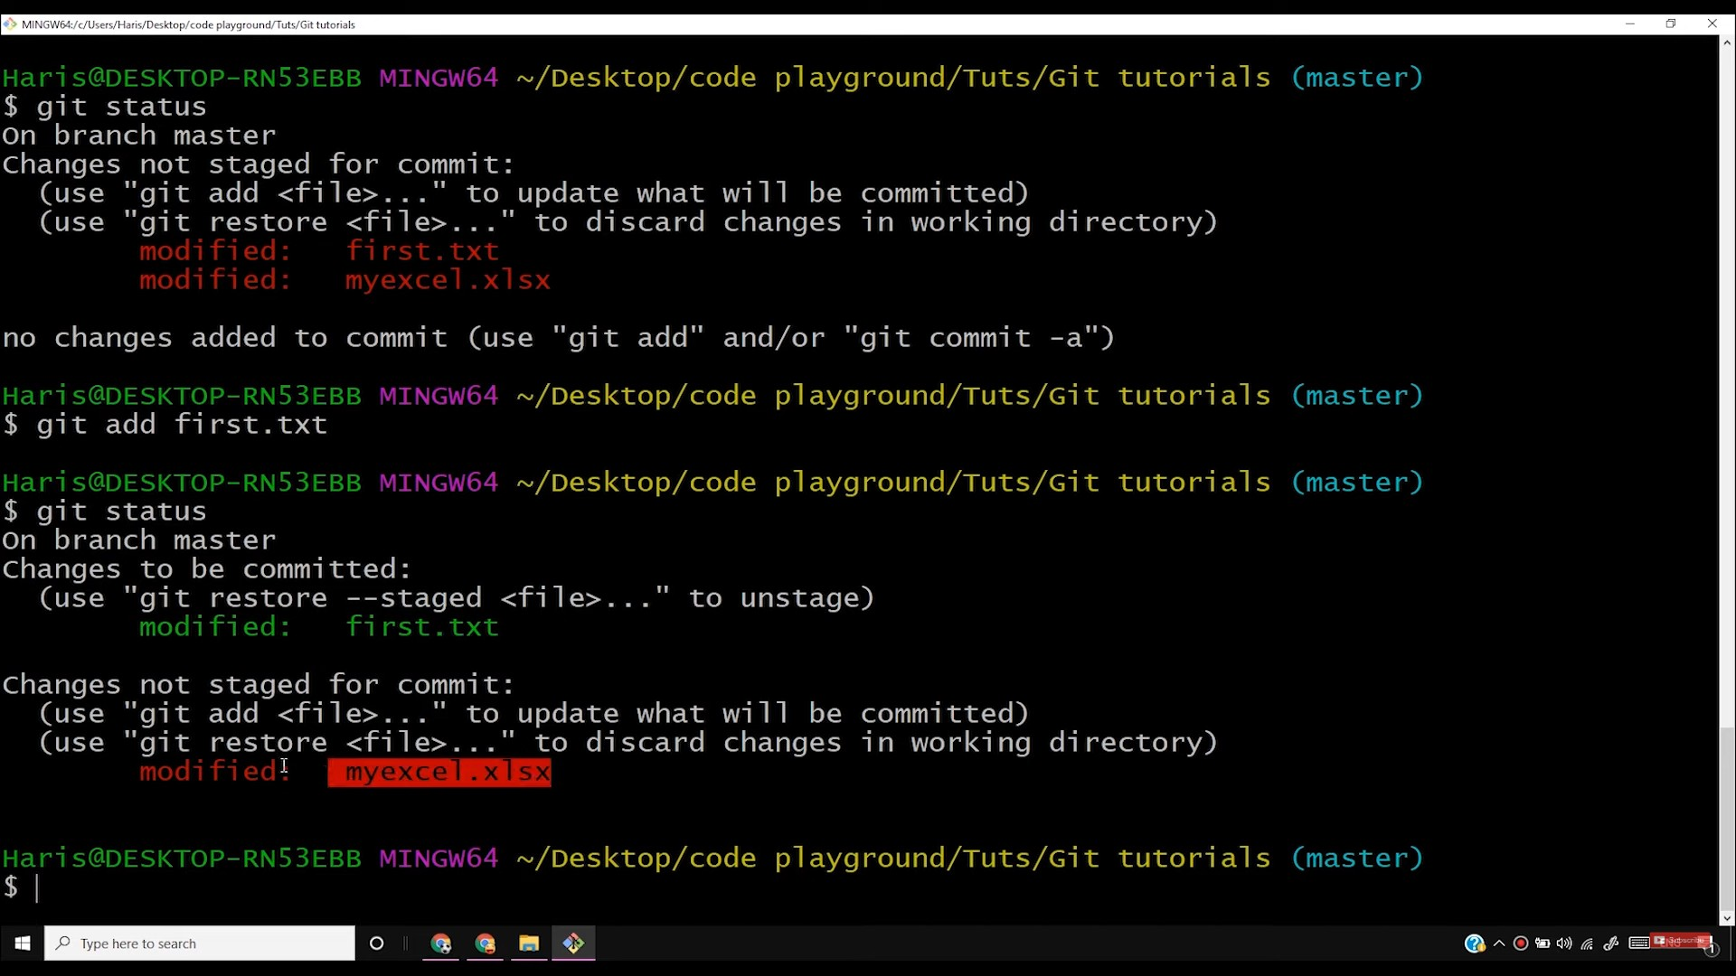

Slide 12
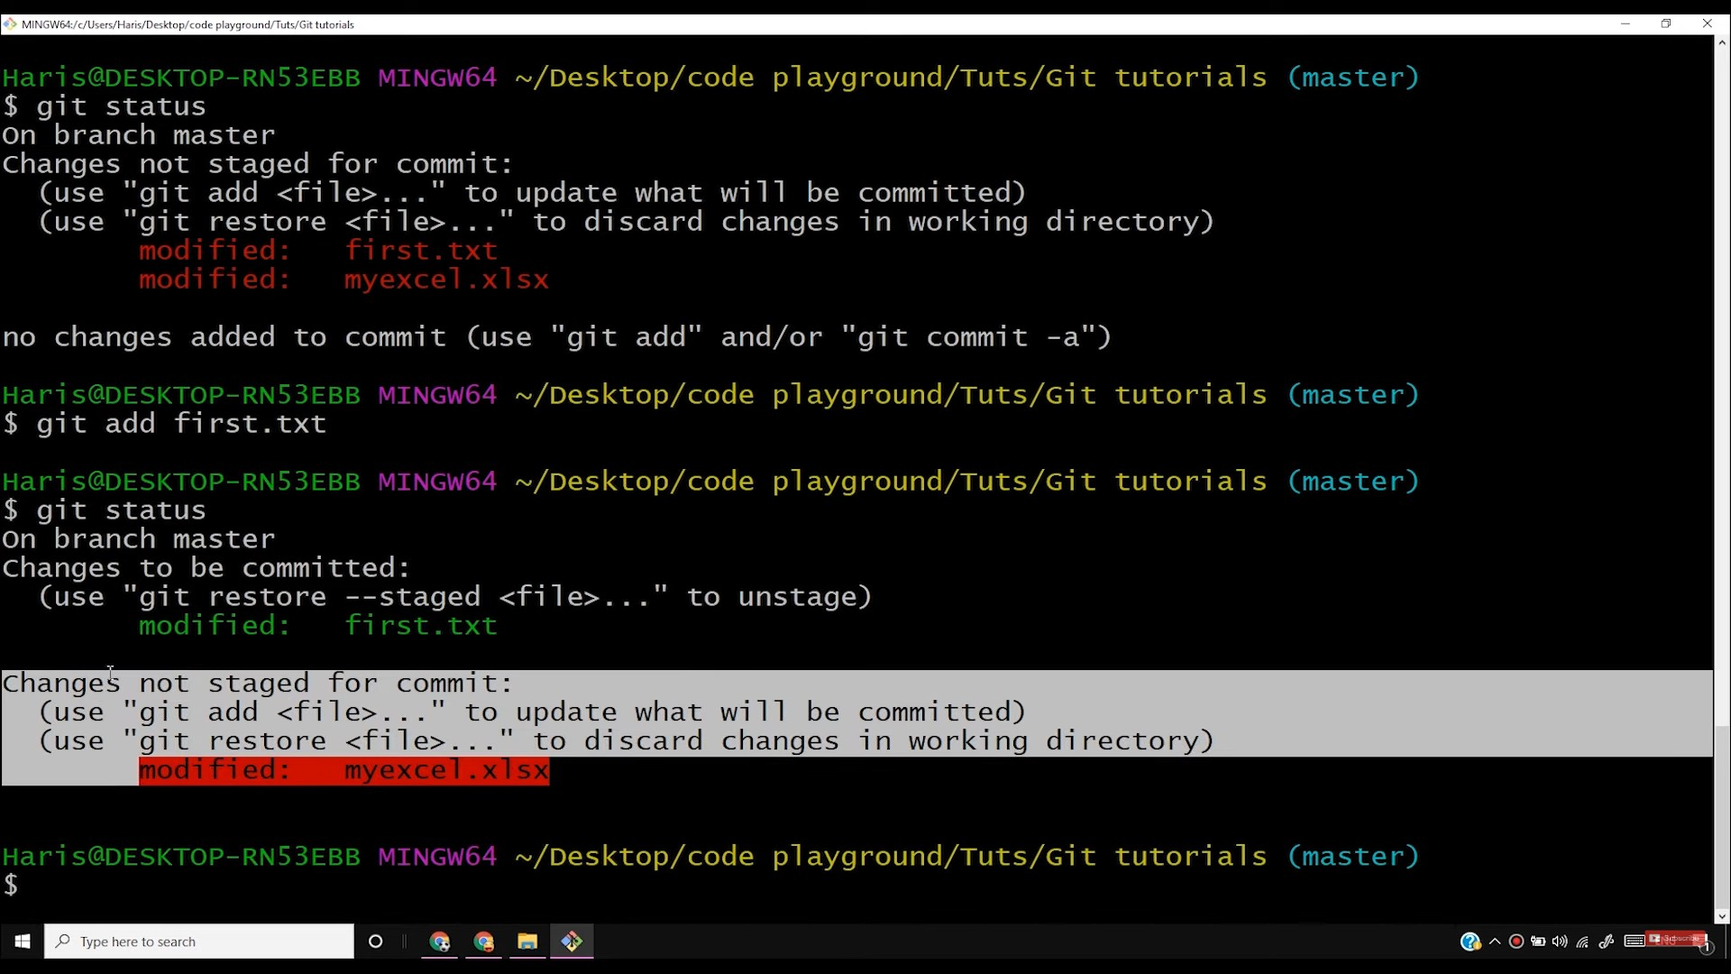

Slide 13
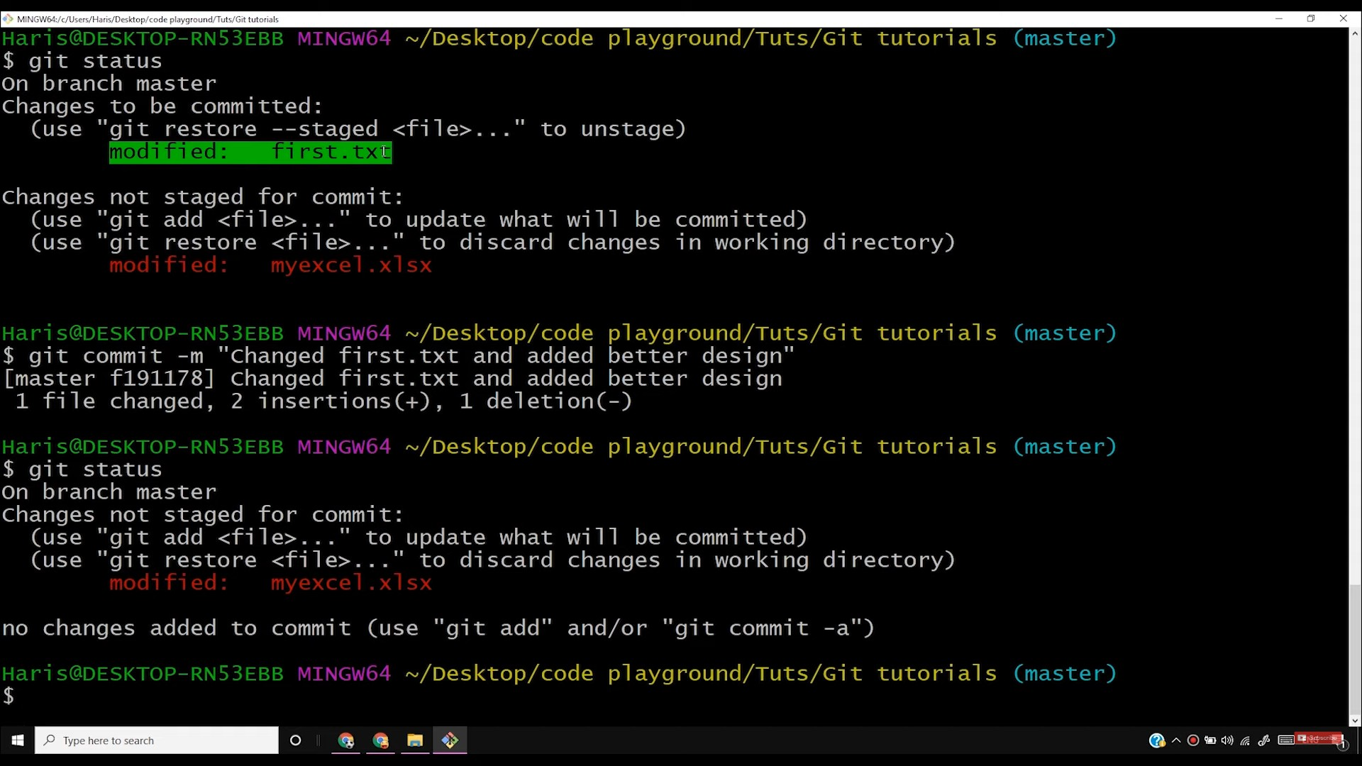

Slide 14
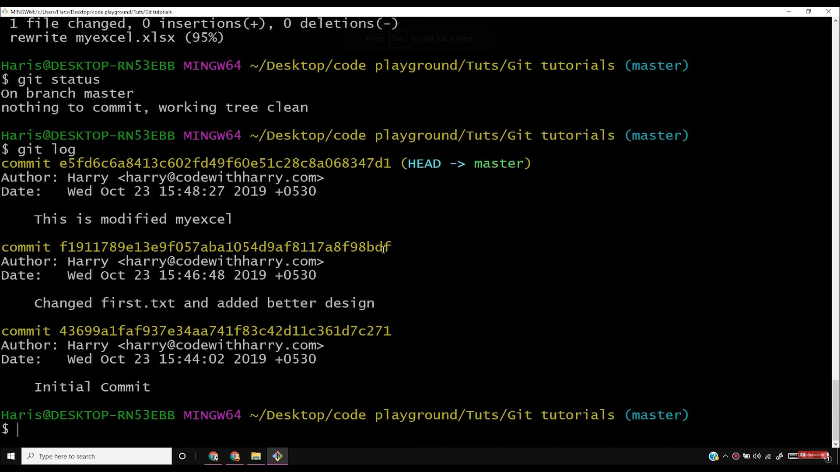

Slide 15
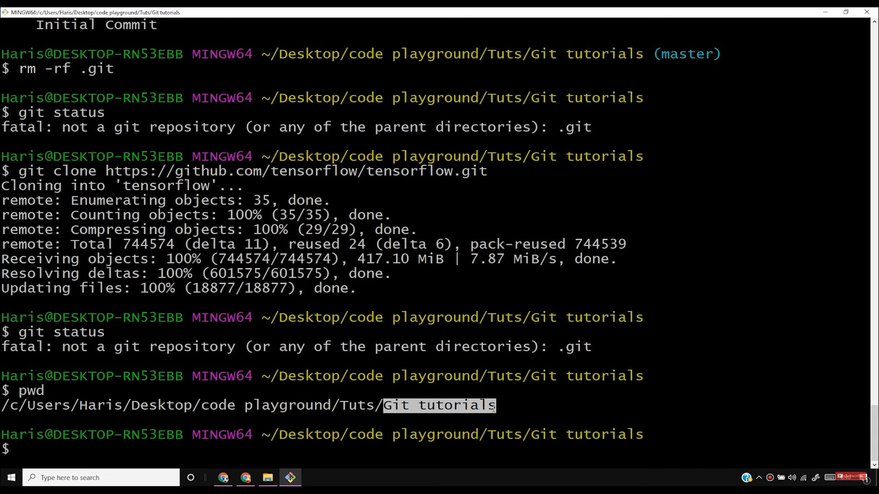

Slide 16
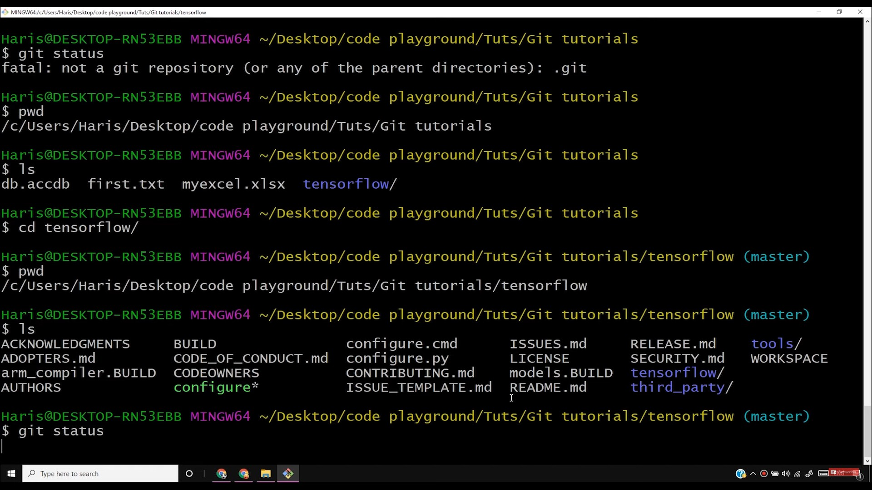

Slide 17
•
Haris@DESKTOP-RN53EBB MINGW64 ~/Desktop/code playground/Tuts/Git tutorials/tensorflow (master)
$ git add -a
error: unknown switch ·a•
usage: git add [<options>] [--] <pathspec> ...
-n, --dry-run dry run
-v, --verbose be verbose
--interactive interactive picking
-p, --patch[=<patch-mode>]
-7 '
select hunks interactively edit current diff and apply
allow adding otherwise ignored files update tracked files
renormalize EOL of tracked files (implies -u)
record only the fact that the path will be added later
-e, --edit
-f, --force
-u, --update
--renormalize
-N, --intent-to-add
-A, --all
--ignore-removal
--refresh
--ignore-errors
--1gnore-m1ss1ng
--chmod (+1-)x
add changes from all tracked and untracked files
ignore paths removed in the working tree (same as --no-all)
don't add, only refresh the index
just skip files which cannot be added because of errors check if - even missing - files are ignored in dry run override the executable bit of the listed files
. . .
Haris@DESKTOP-RN53EBB MINGW64 ~/Desktop/code playground/Tuts/Git tutorials/tensorflow (master)
$
git add --a
Haris@DESKTOP-RN53EBB MINGW64 ~/Desktop/code playground/Tuts/Git tutorials/tensorflow (master)
$ I
•=
0
^{II} 11.1 l!I
----
® A ® >)) ft1i ,J.I, 14'=-"1I

Slide 18
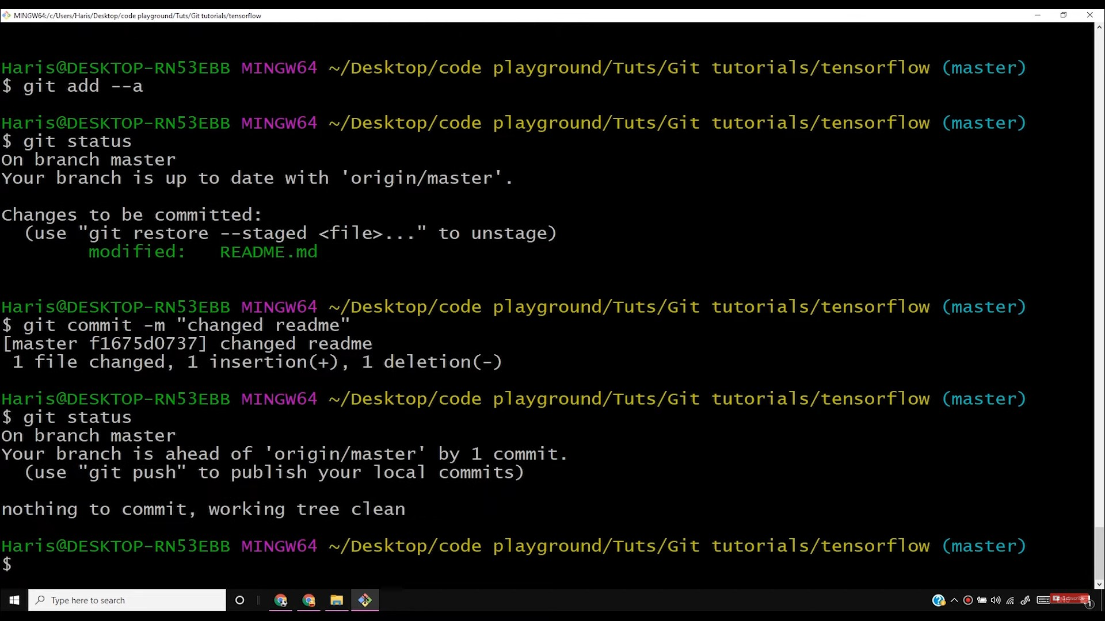

Slide 19
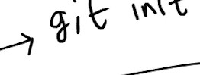


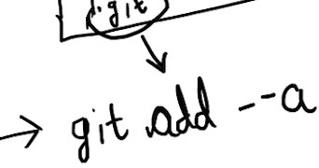

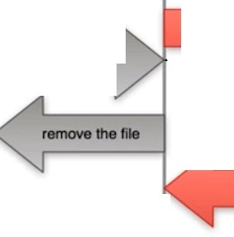

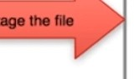


------7 s,\o Y
\
.fD \ "")'.2,, . •
EEl
,.., k- -
- ,F.i.l.e_{c}S:ta₋tu_{,c}s L·ifecycle
(,--staged-)
-\ , v.,.\-,, ) o, .,k O:-:_((; i,Jo..J ,
\".'... j --
r---_J
...,._.,
1
I -
Ollllffll
) +)...
cam

Slide 20
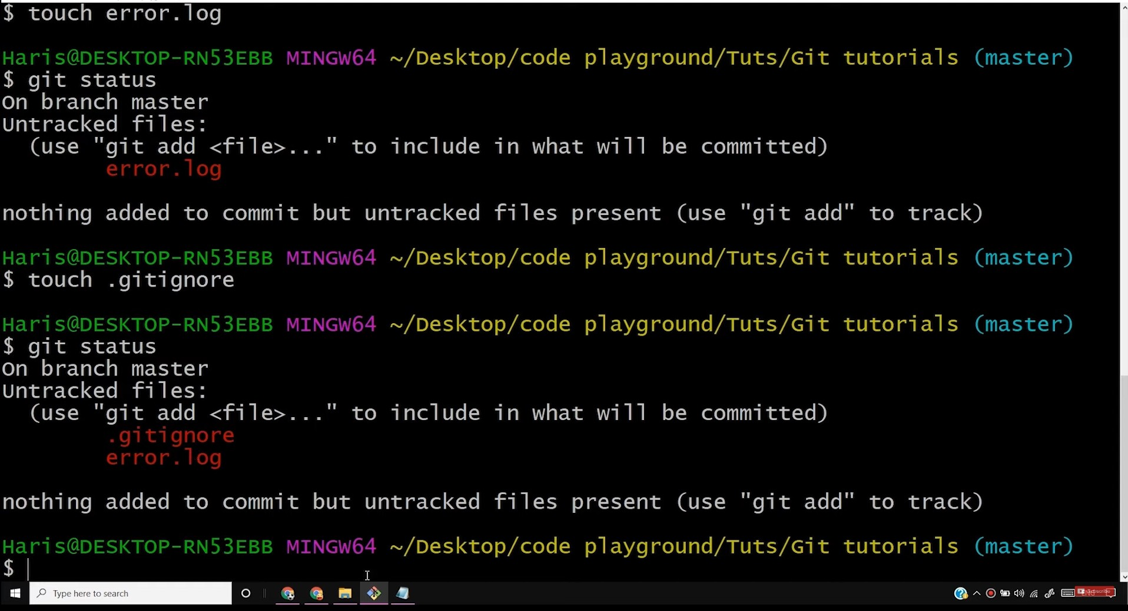
f'1, MINGWl>'!Jc/lk,,,,/Ha<;>f[)e,lctop/<oOe.playwounO/T ut>!Git tuto,ial,
0
X

Slide 21
.git:ignore • Notepad
File Edit Format View Help
error. logl
oJ
X
I
P Type here to search

Slide 22
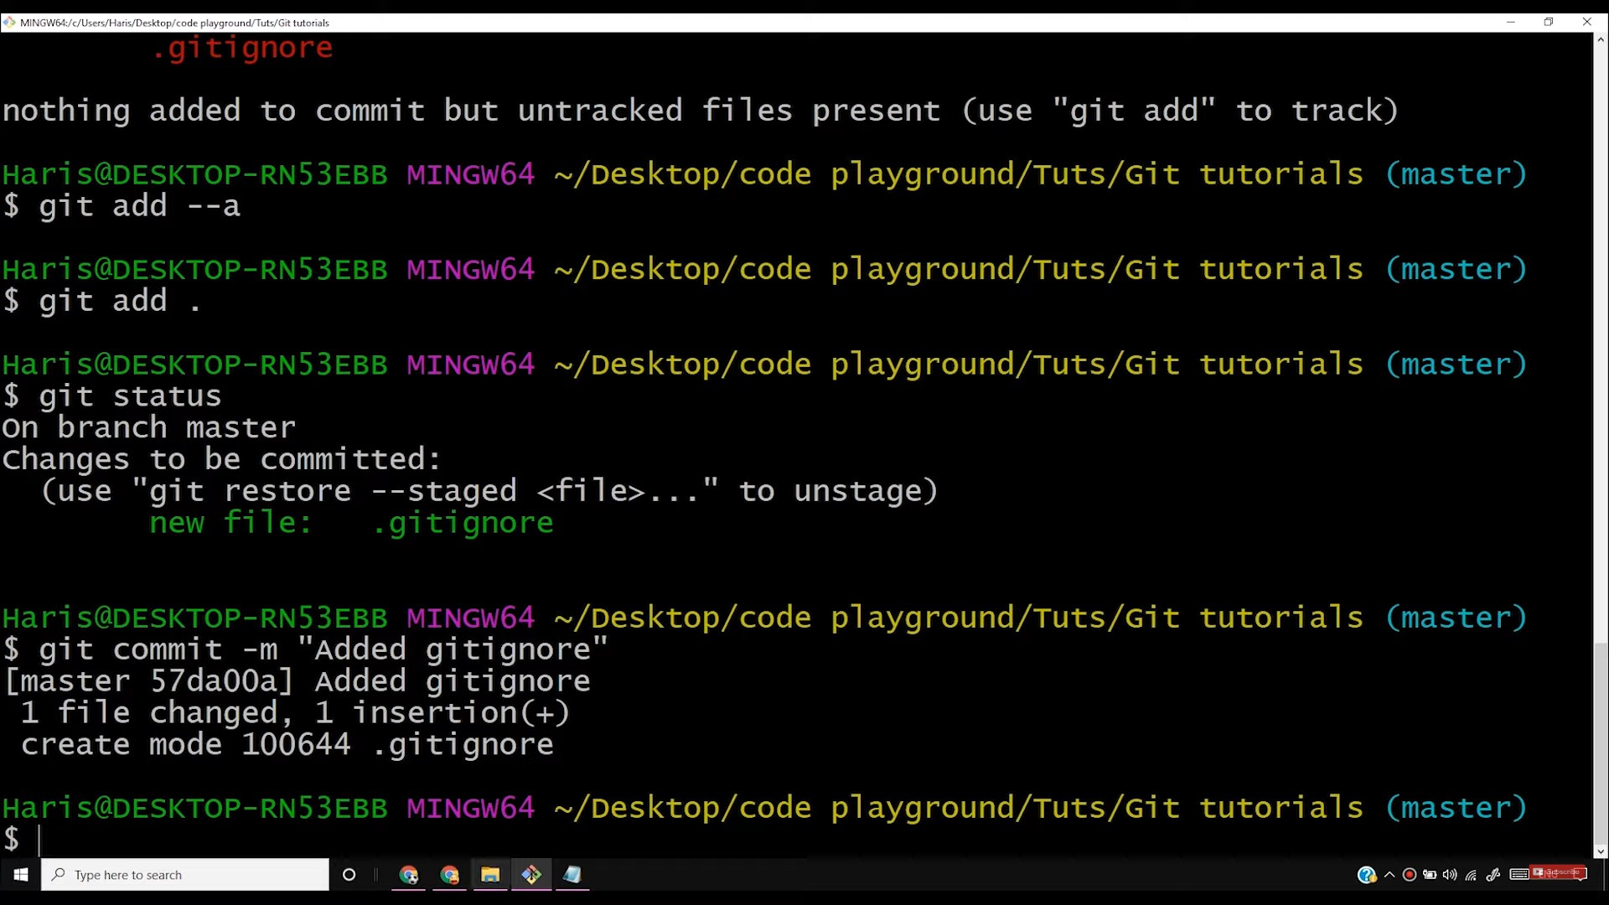

Slide 23
'] .9iti;1nore - Notepad
File Edit Format View Help
*.log
l'.il
X
P Type here to search

Slide 24
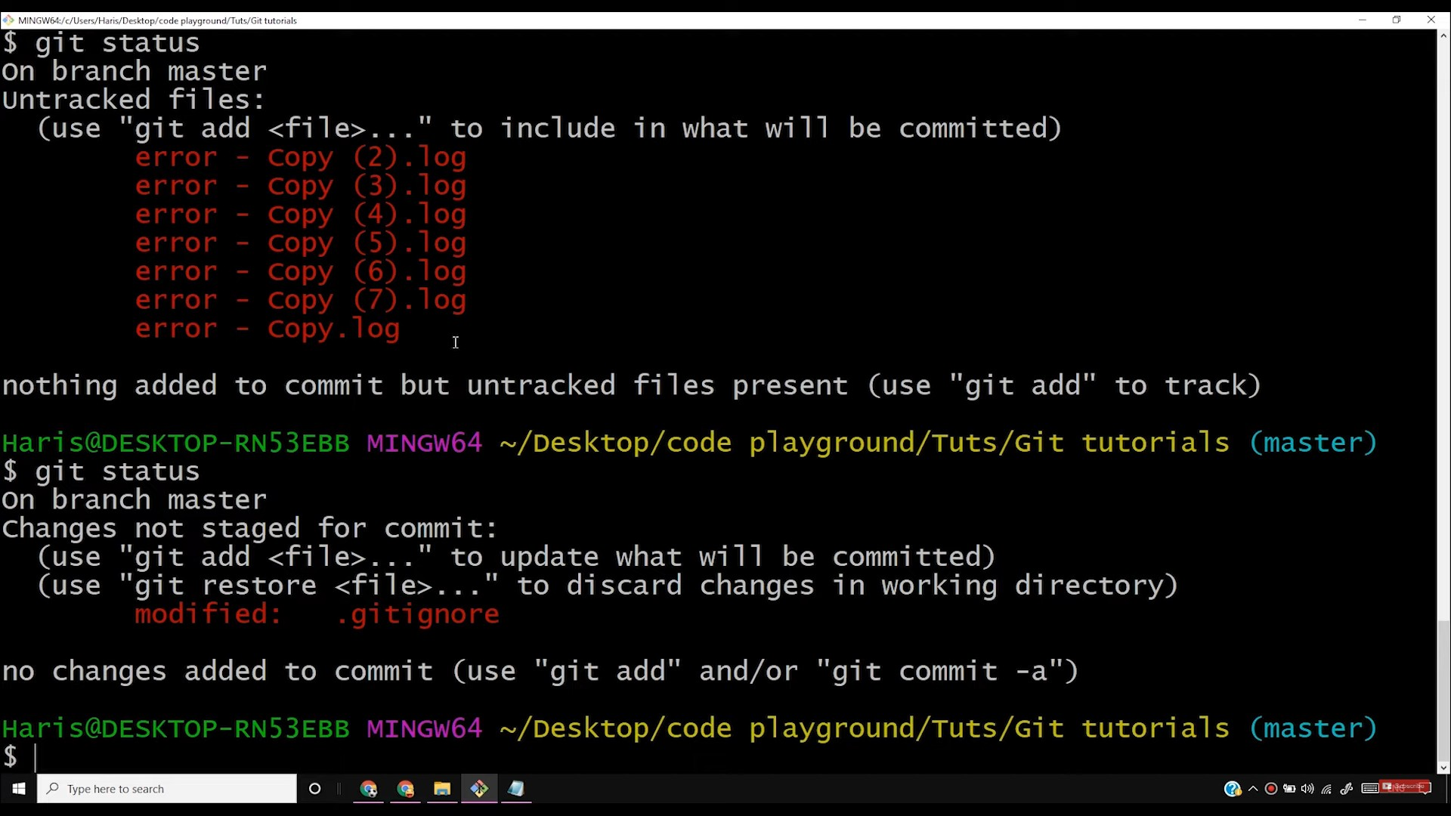

Slide 25
.gitignore • Notepad
File Edit Format View Help
*.log
dir/
X
I
P Type here to search

Slide 26
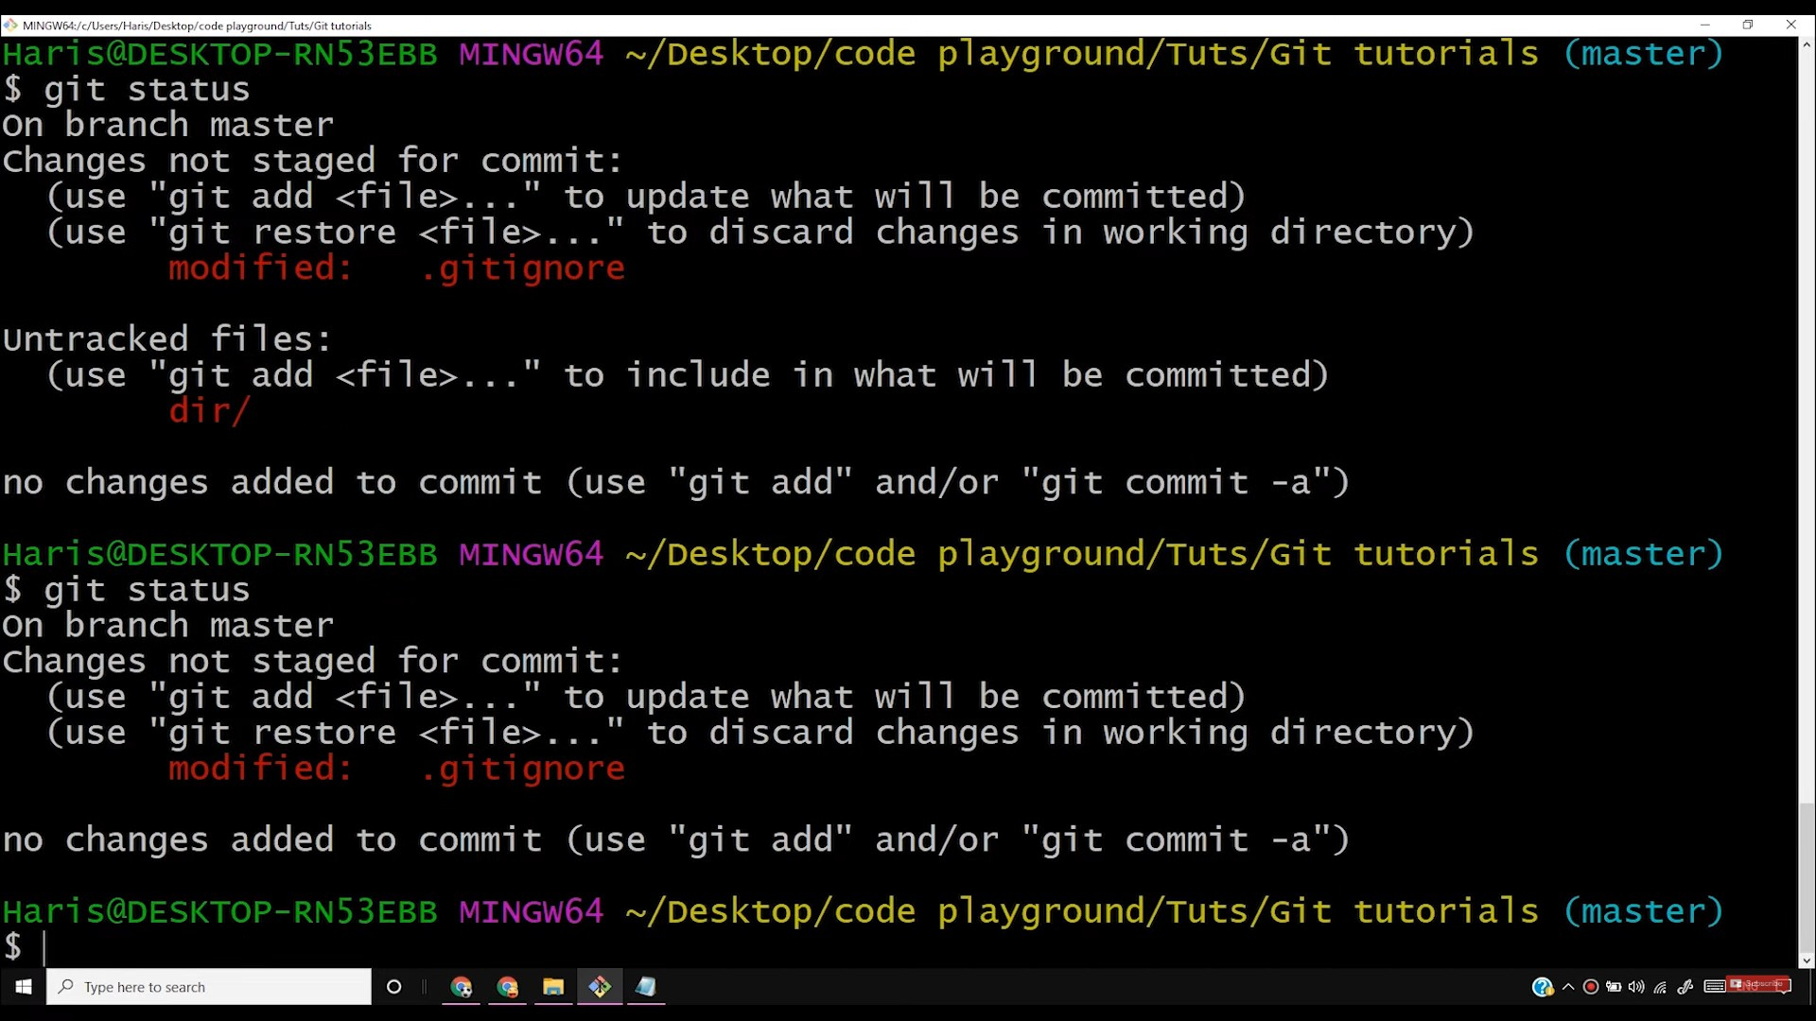

Slide 27
.gitignore • Notepad
File Edrt Format View Hetp
*.log
!ldir/
X
I
P Type here to search

Slide 28
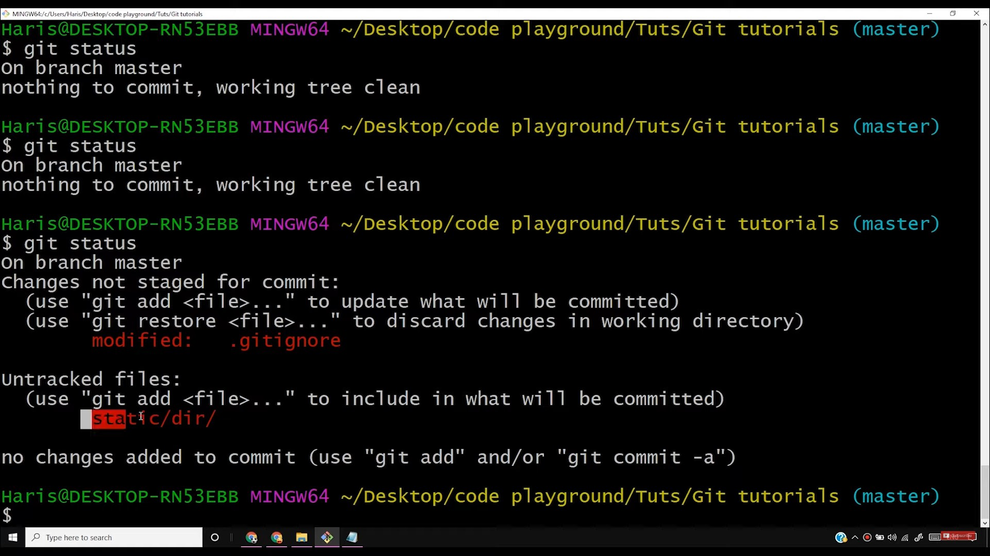

Slide 29
.gitignore • Notepad
File Edrt Format View Help
*.log
dir/
Cil
X
P Type here to search

Slide 30
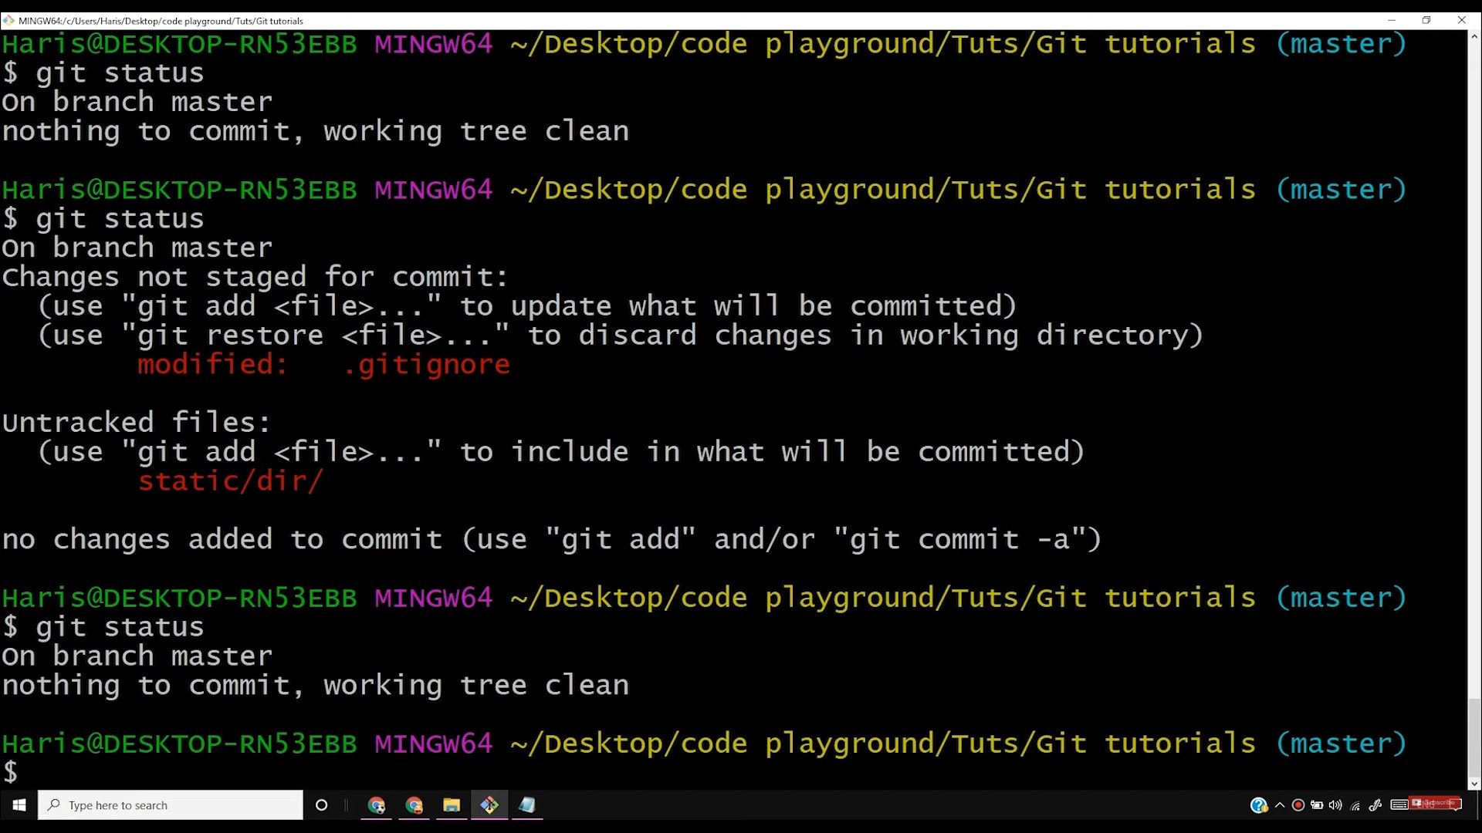

Slide 31
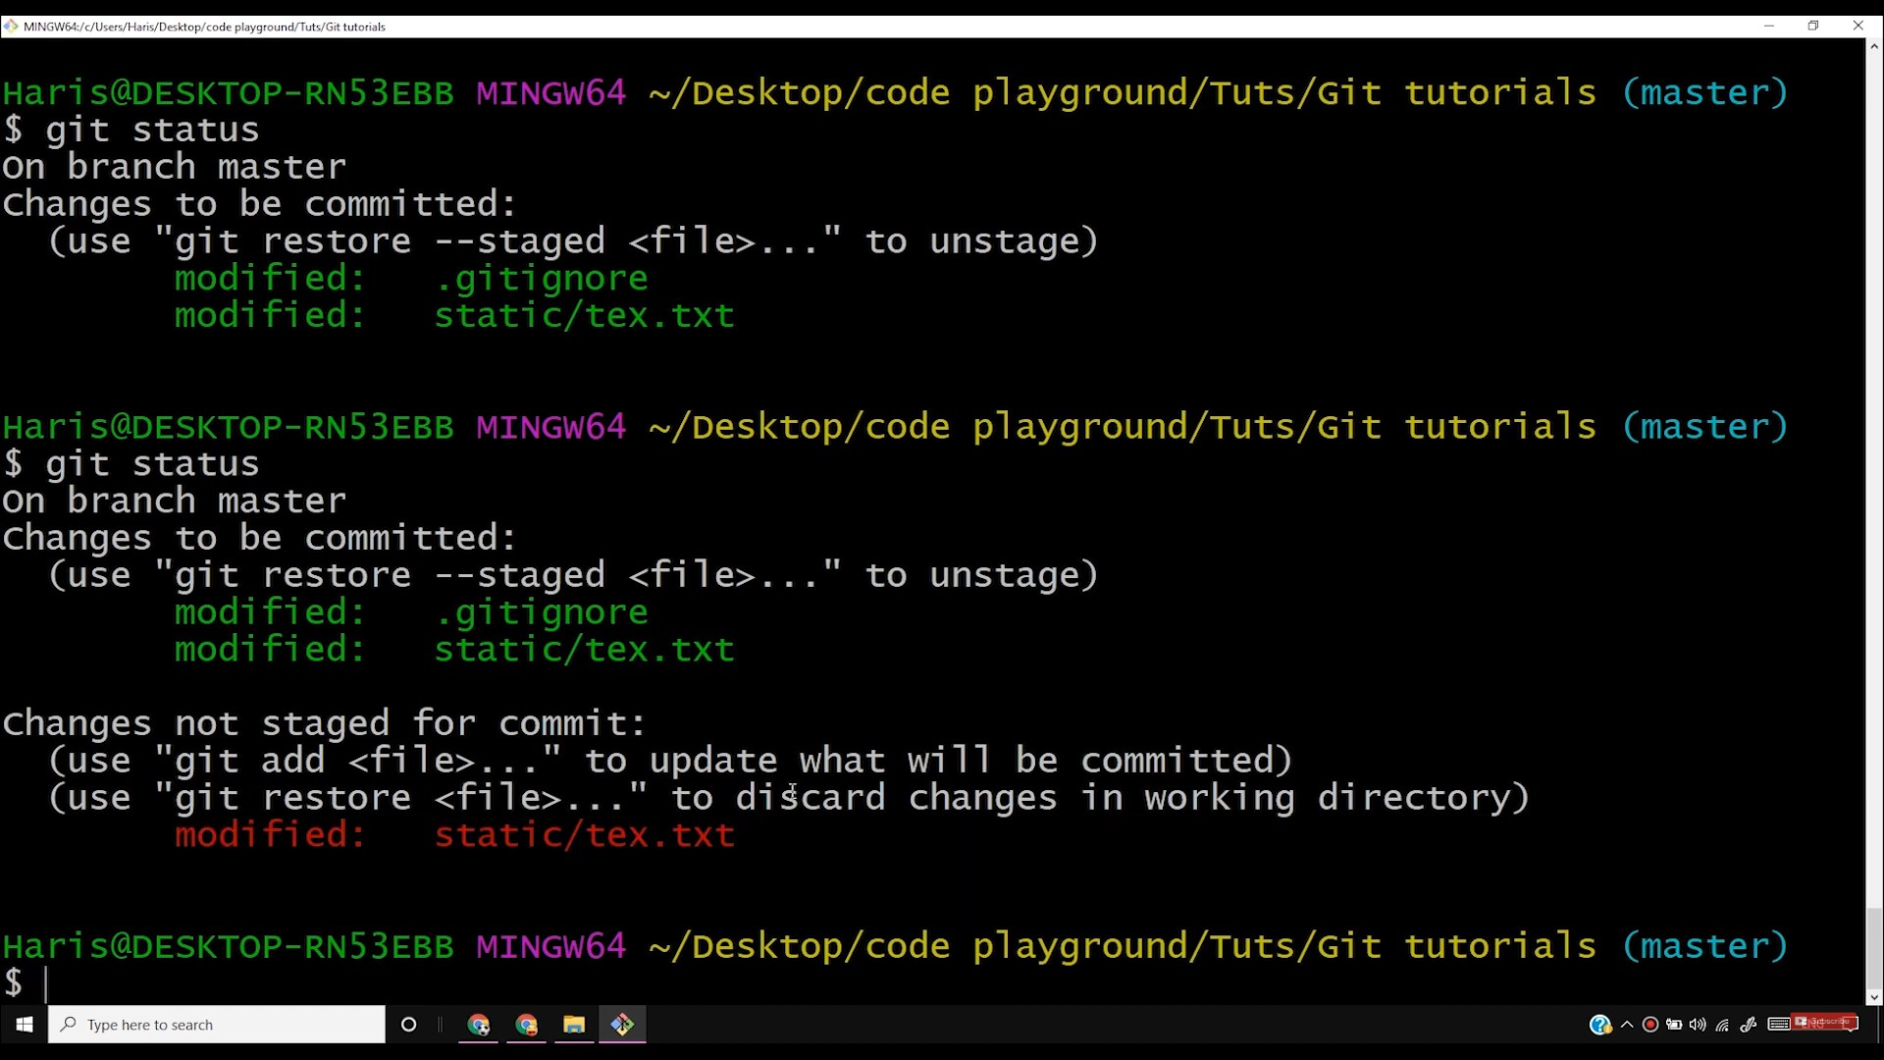

Slide 32
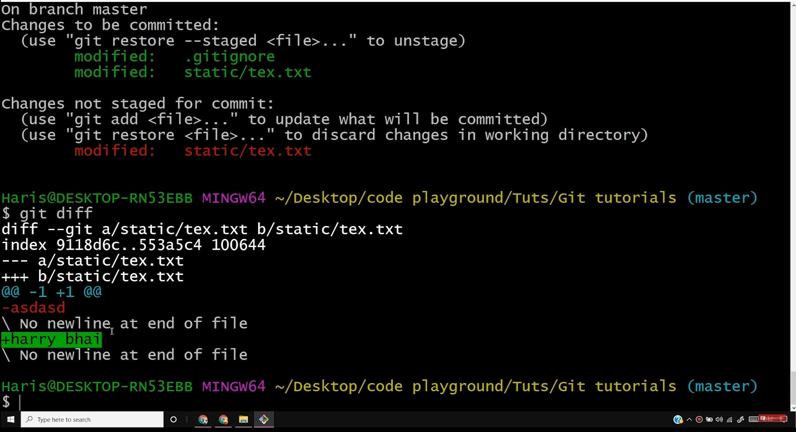
f MINGWl>'!Jc/l!w,/H0<d[)e,lctop/<ode.play •ound/Tut,/Git tuto,ial,
0
X

Slide 33
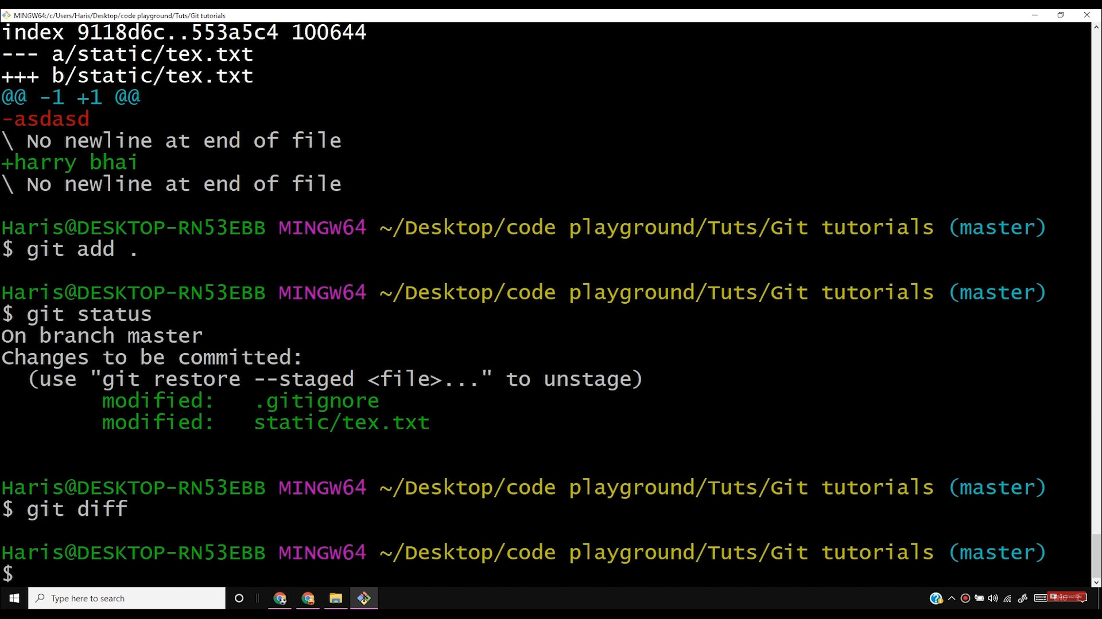

Slide 34
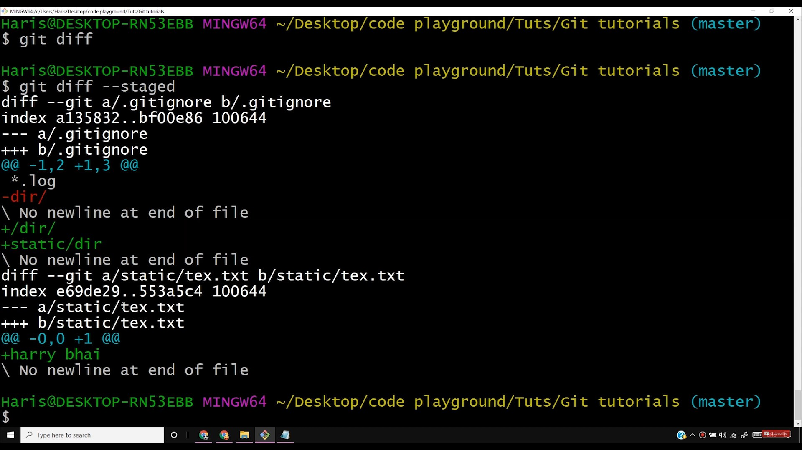

Slide 35
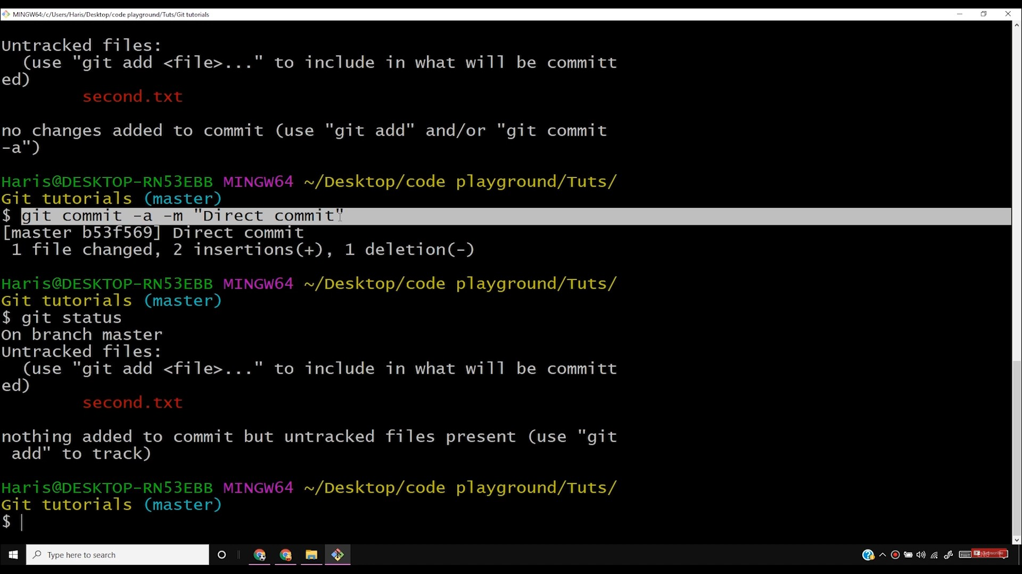

Slide 36
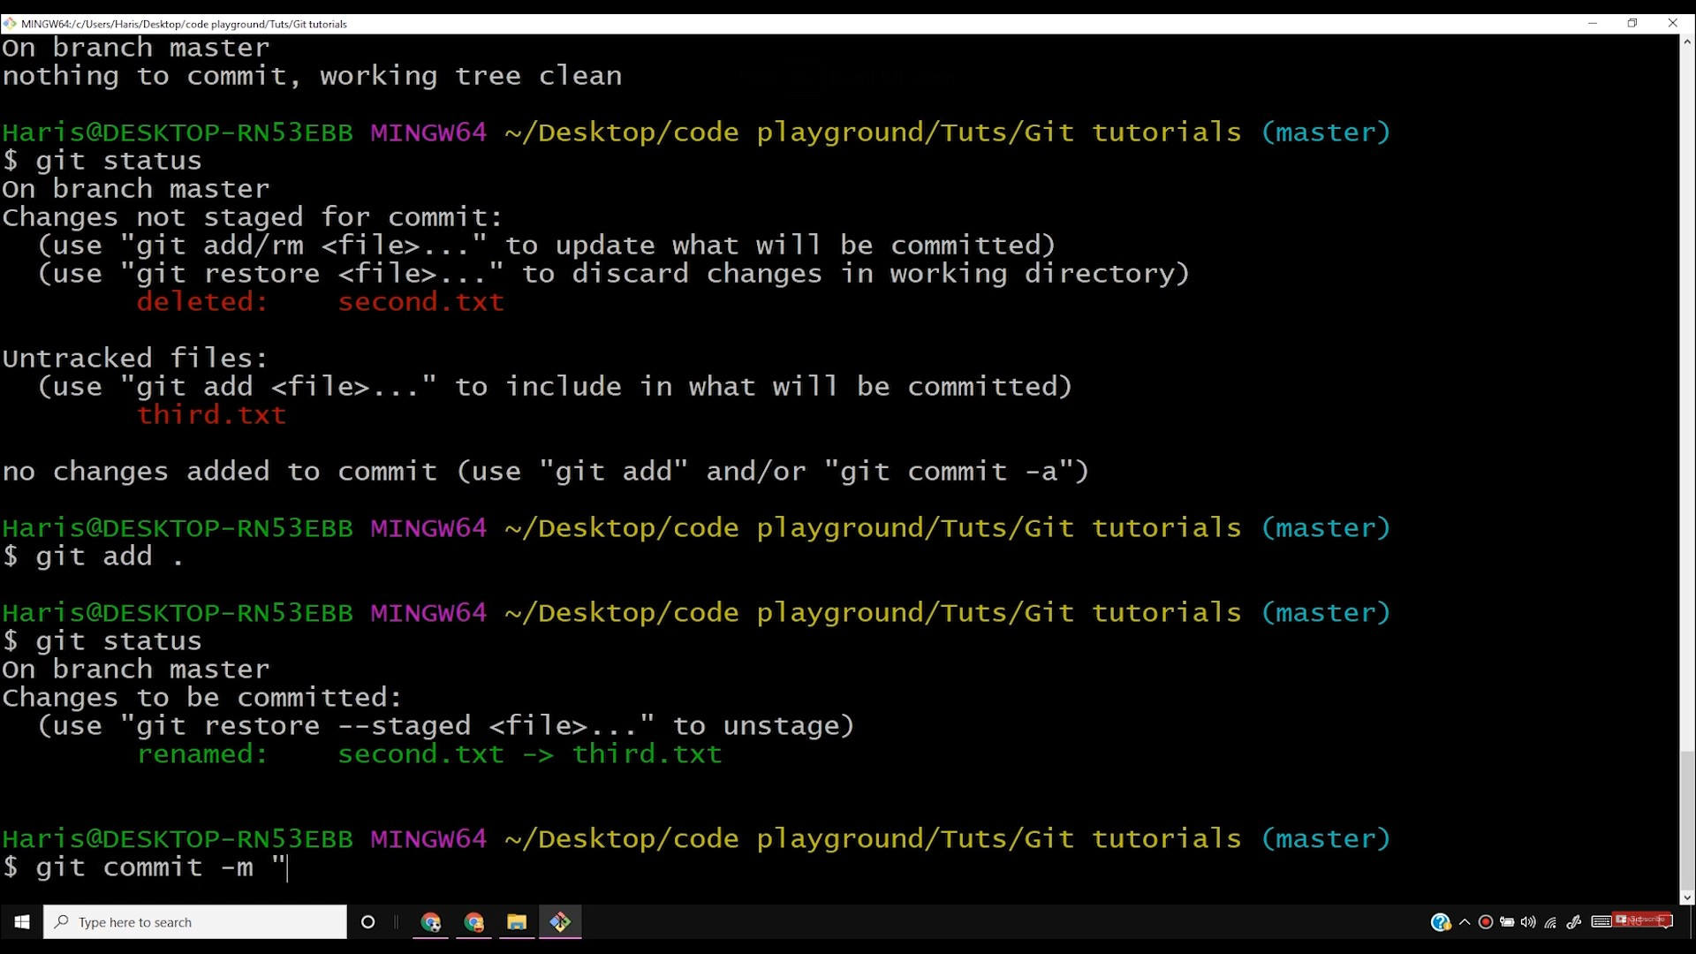

Slide 37
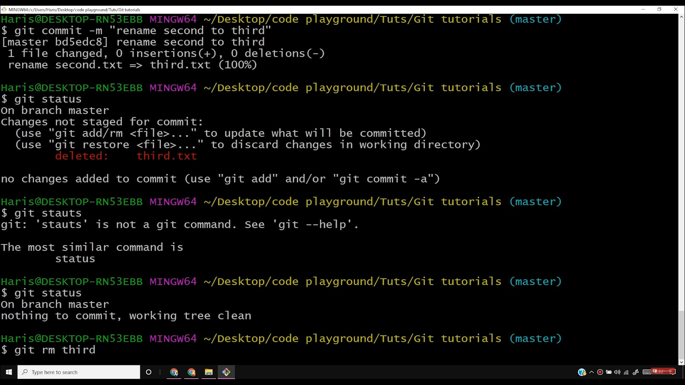

Slide 38
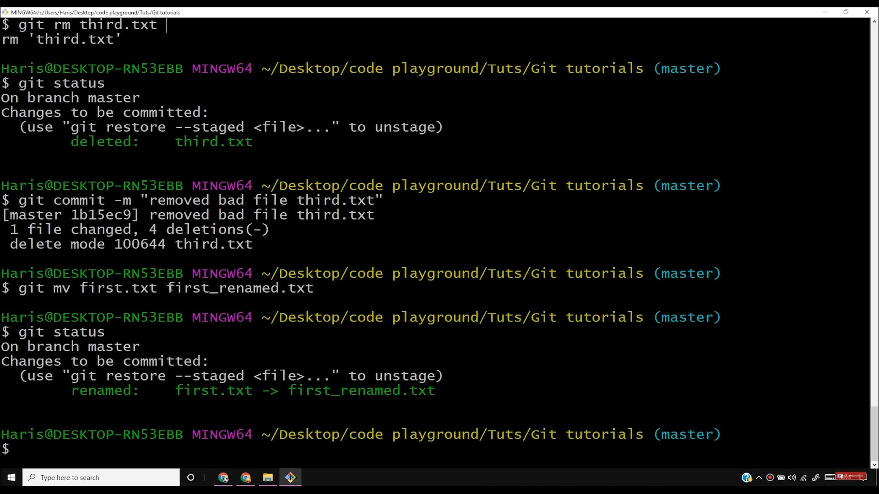

Slide 39
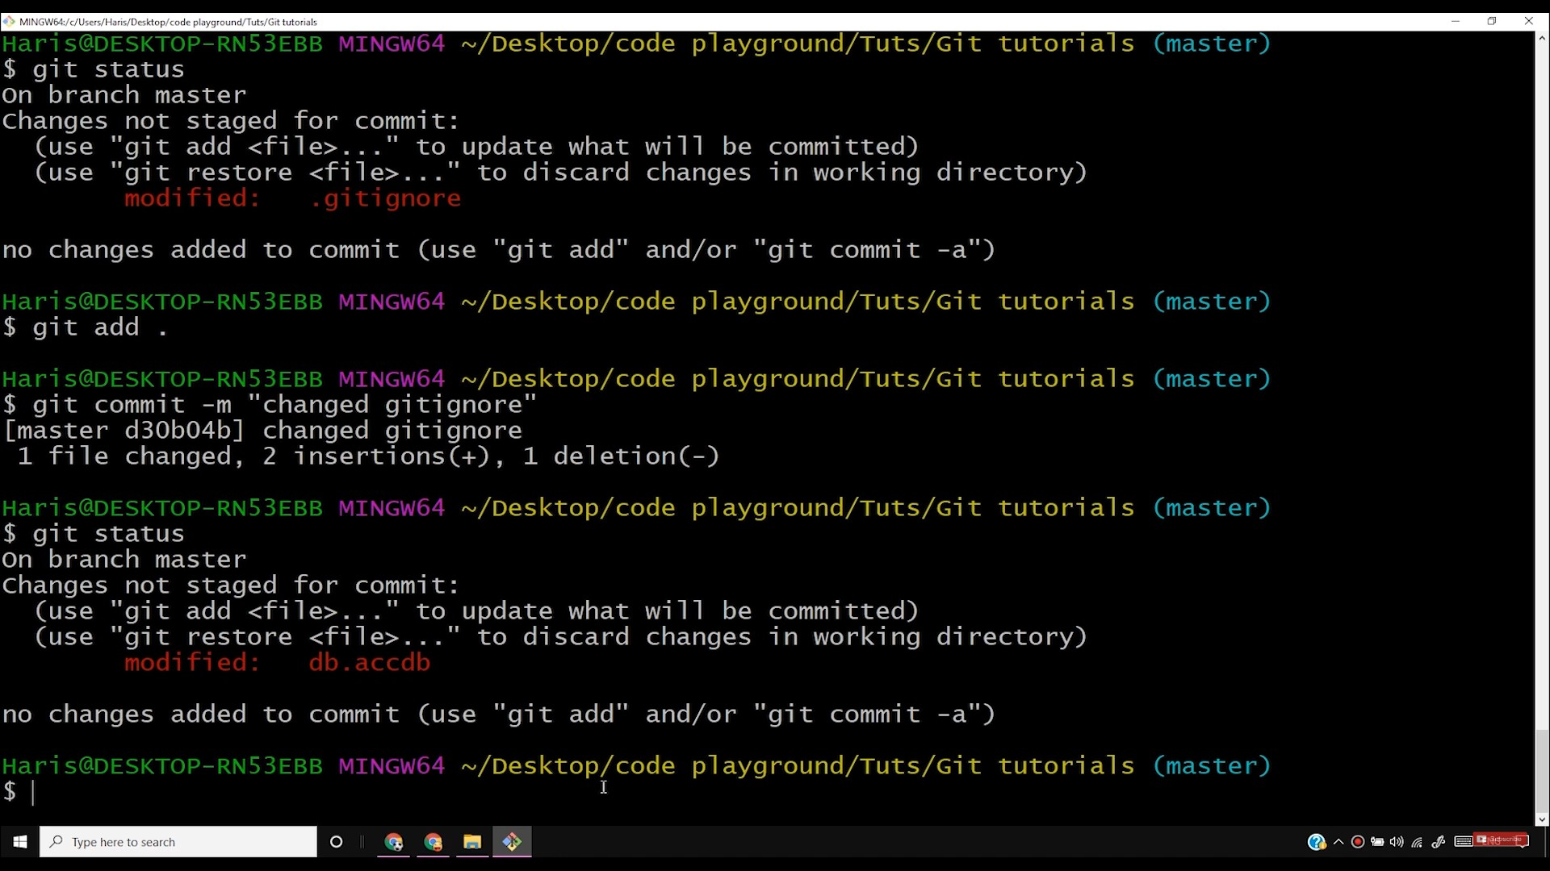

Slide 40
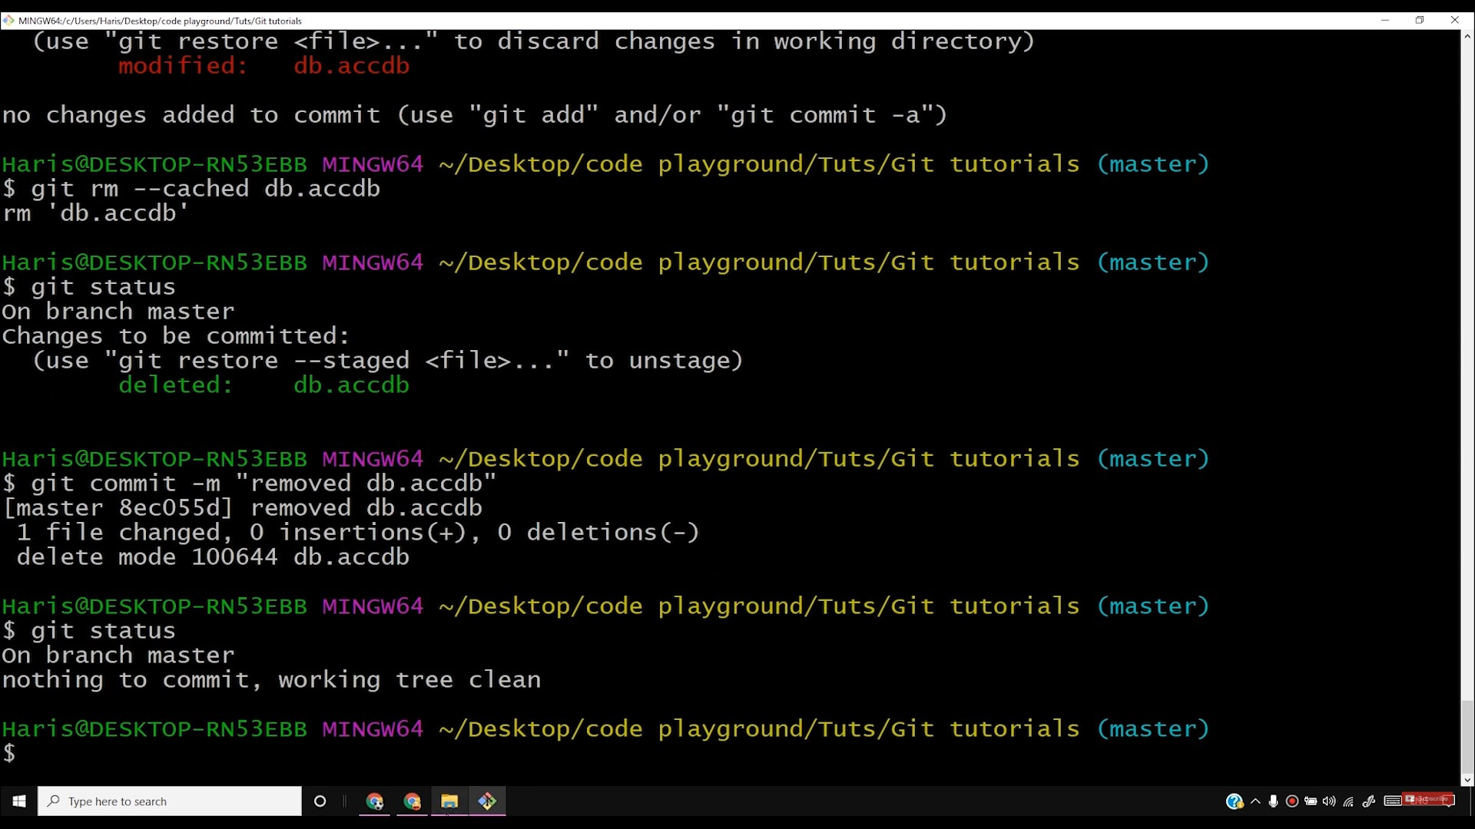

Slide 41
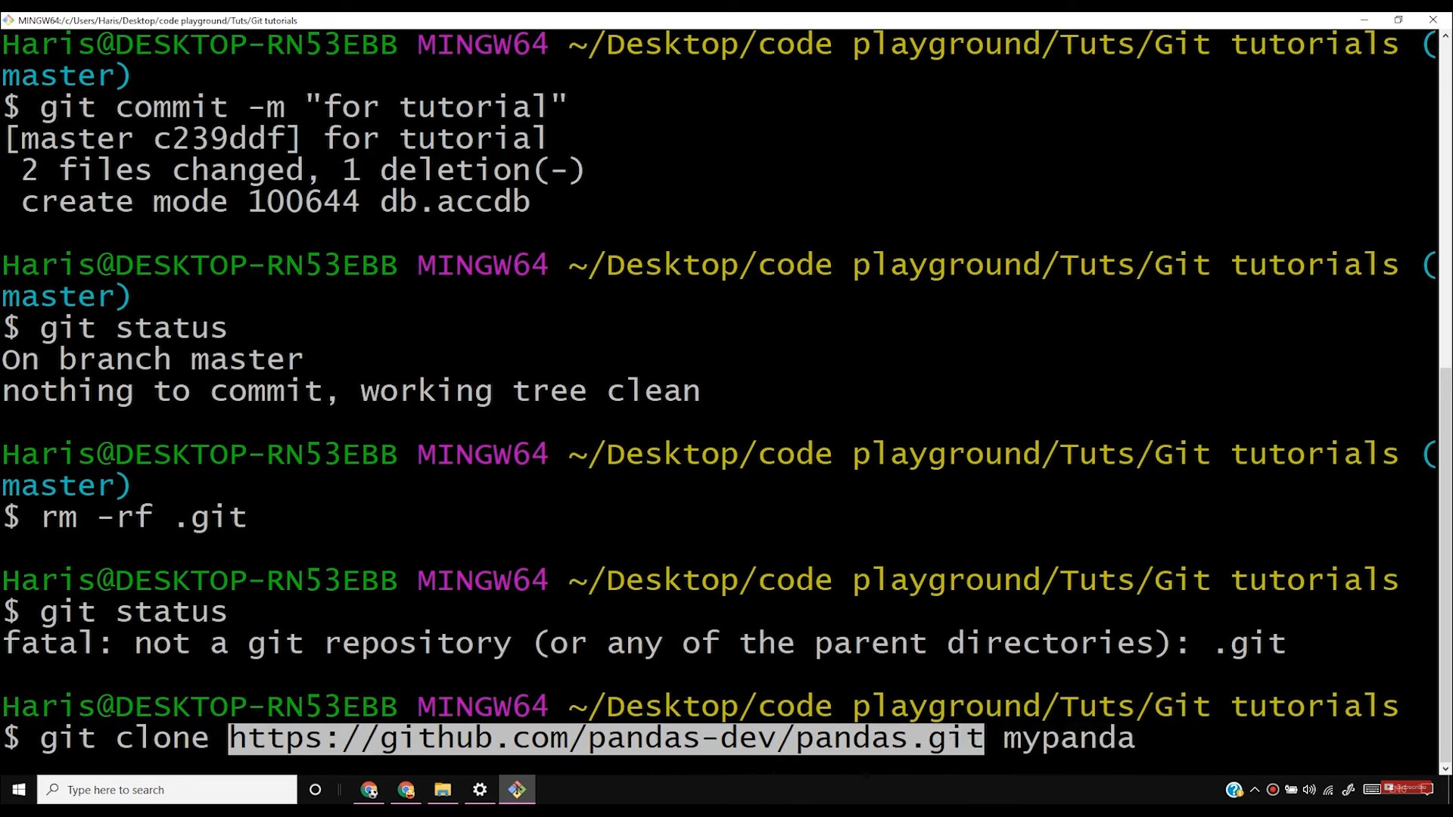

Slide 42
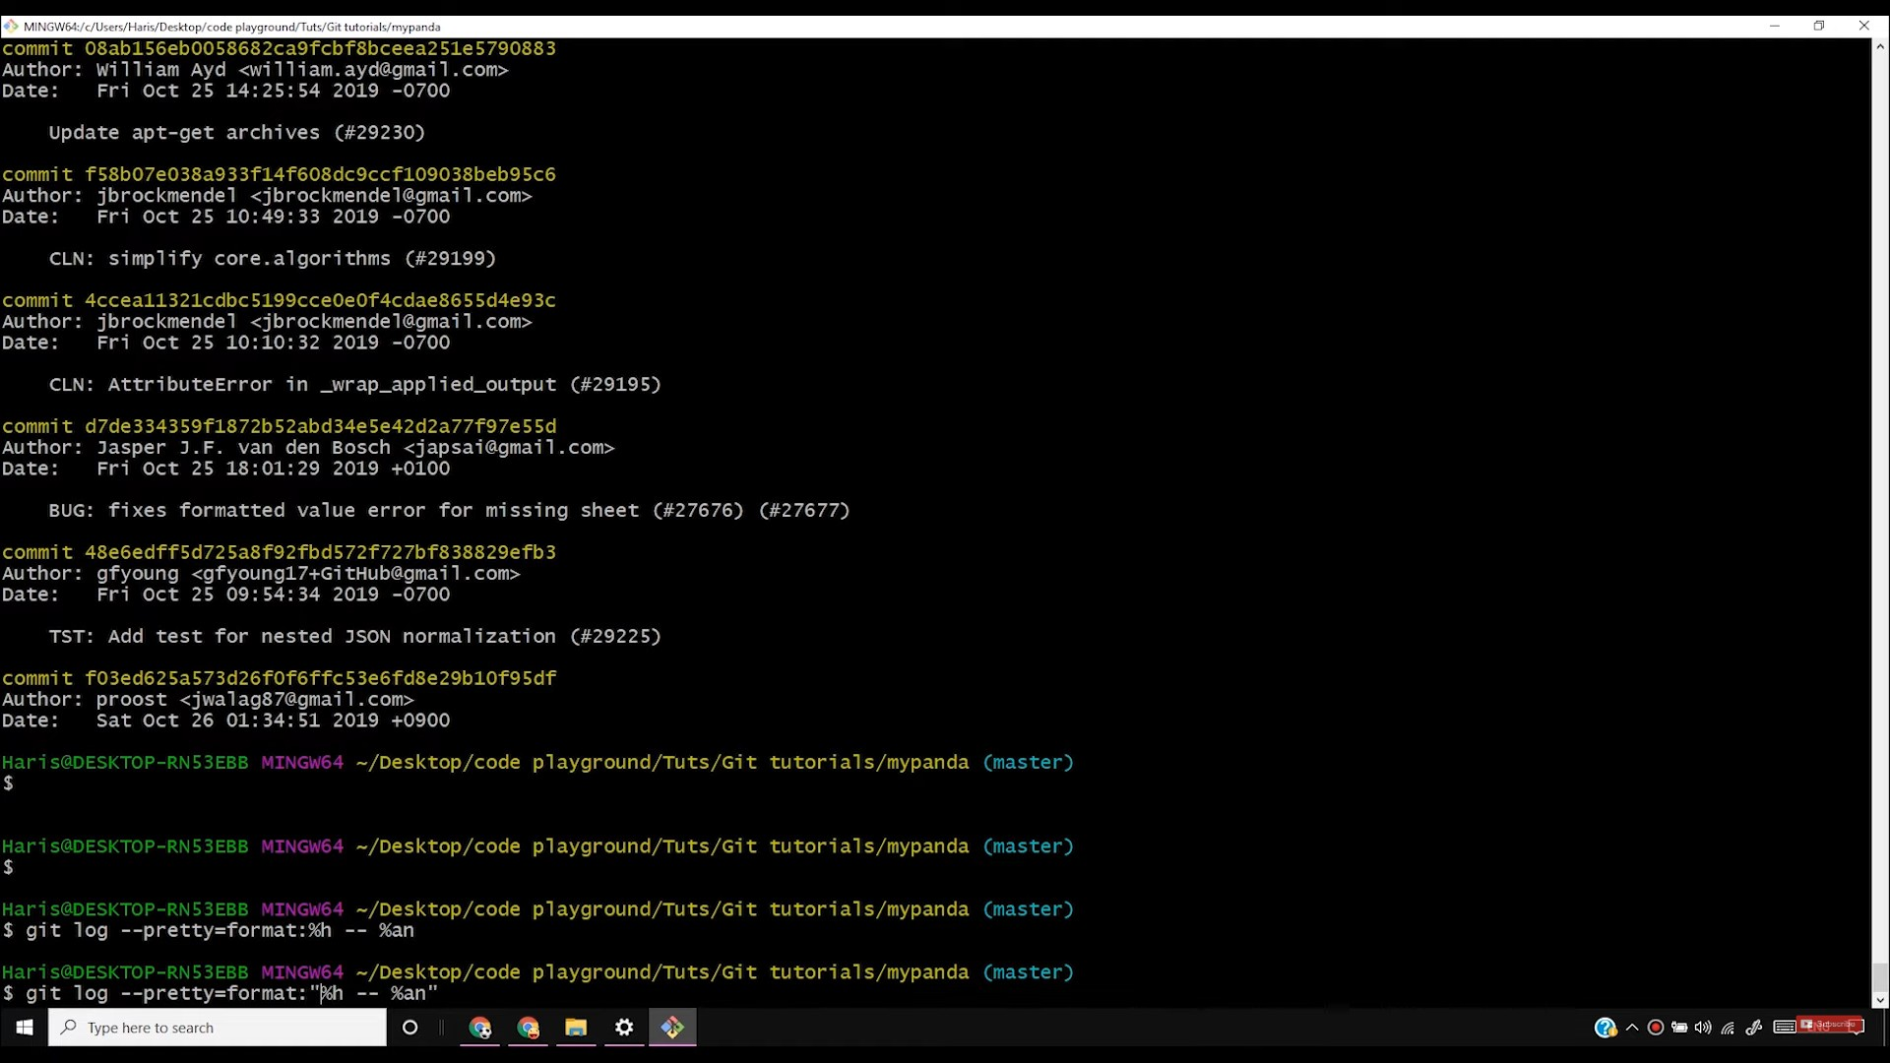

Slide 43
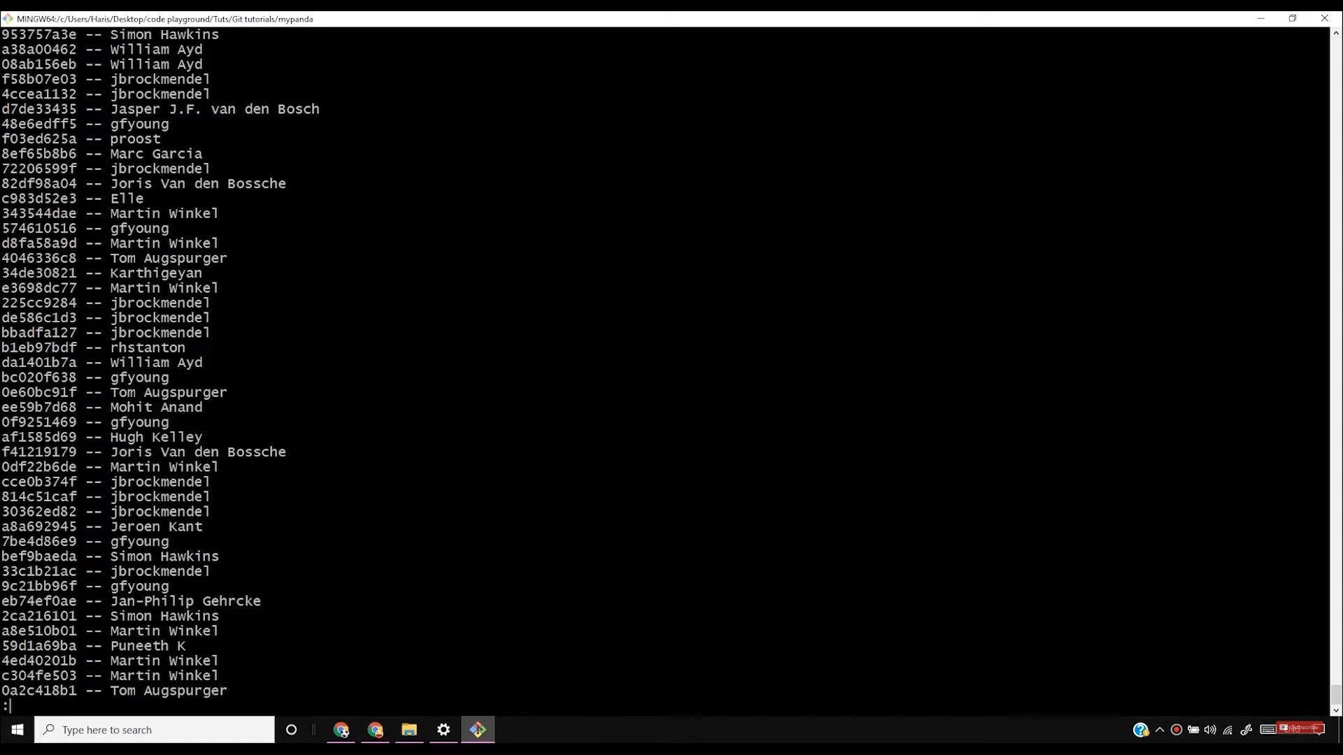

Slide 44
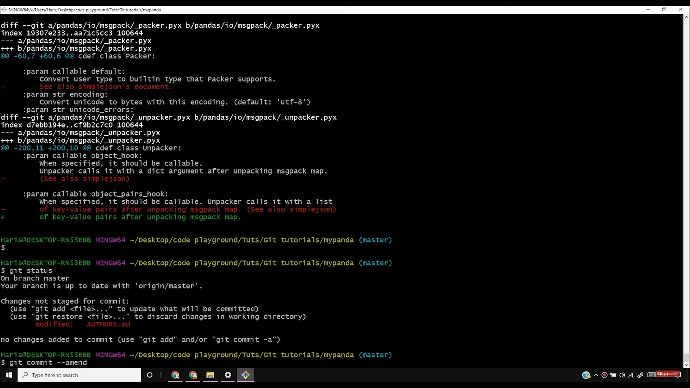

Slide 45
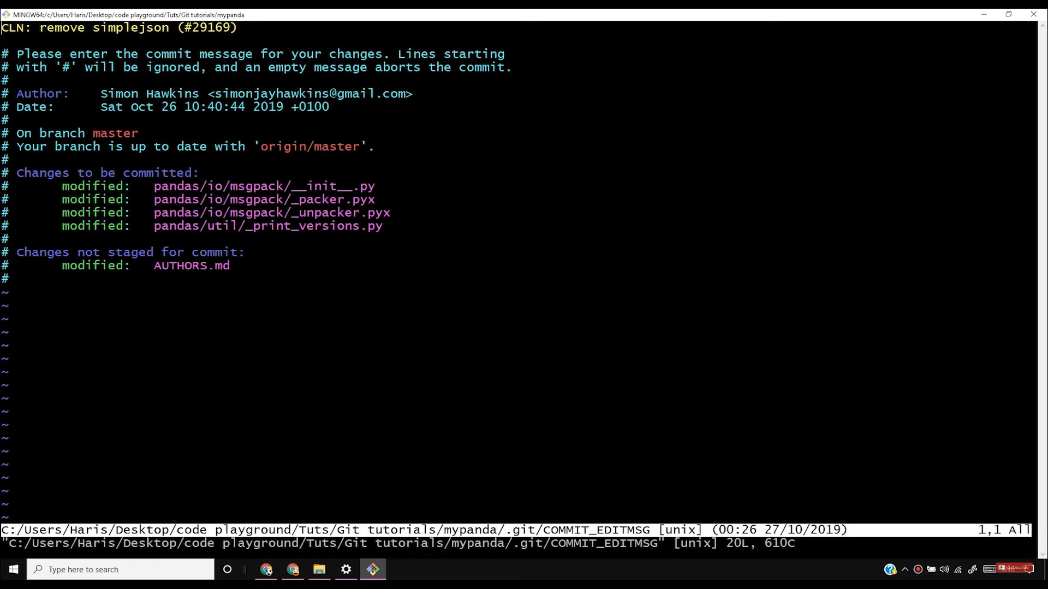

Slide 46
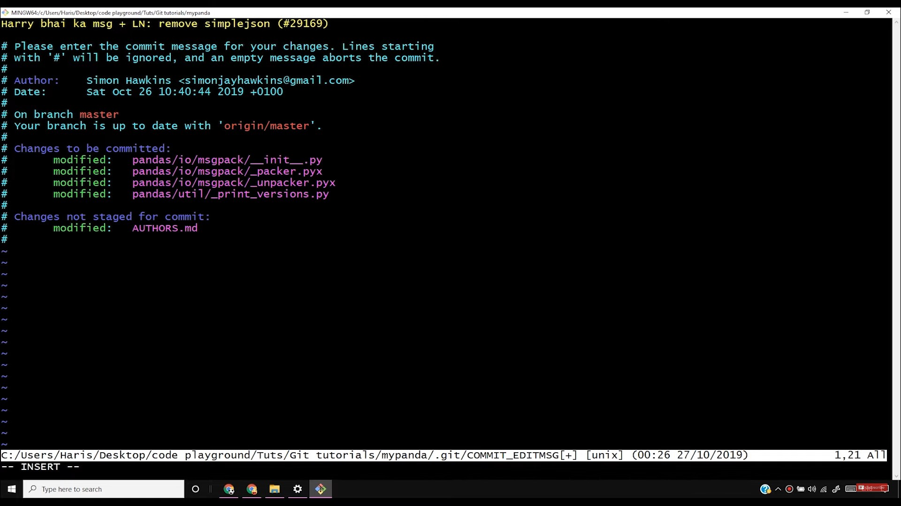

Slide 47


Slide 48
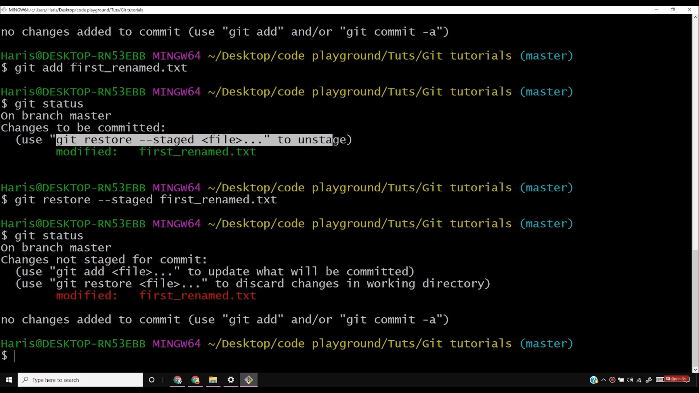

Slide 49
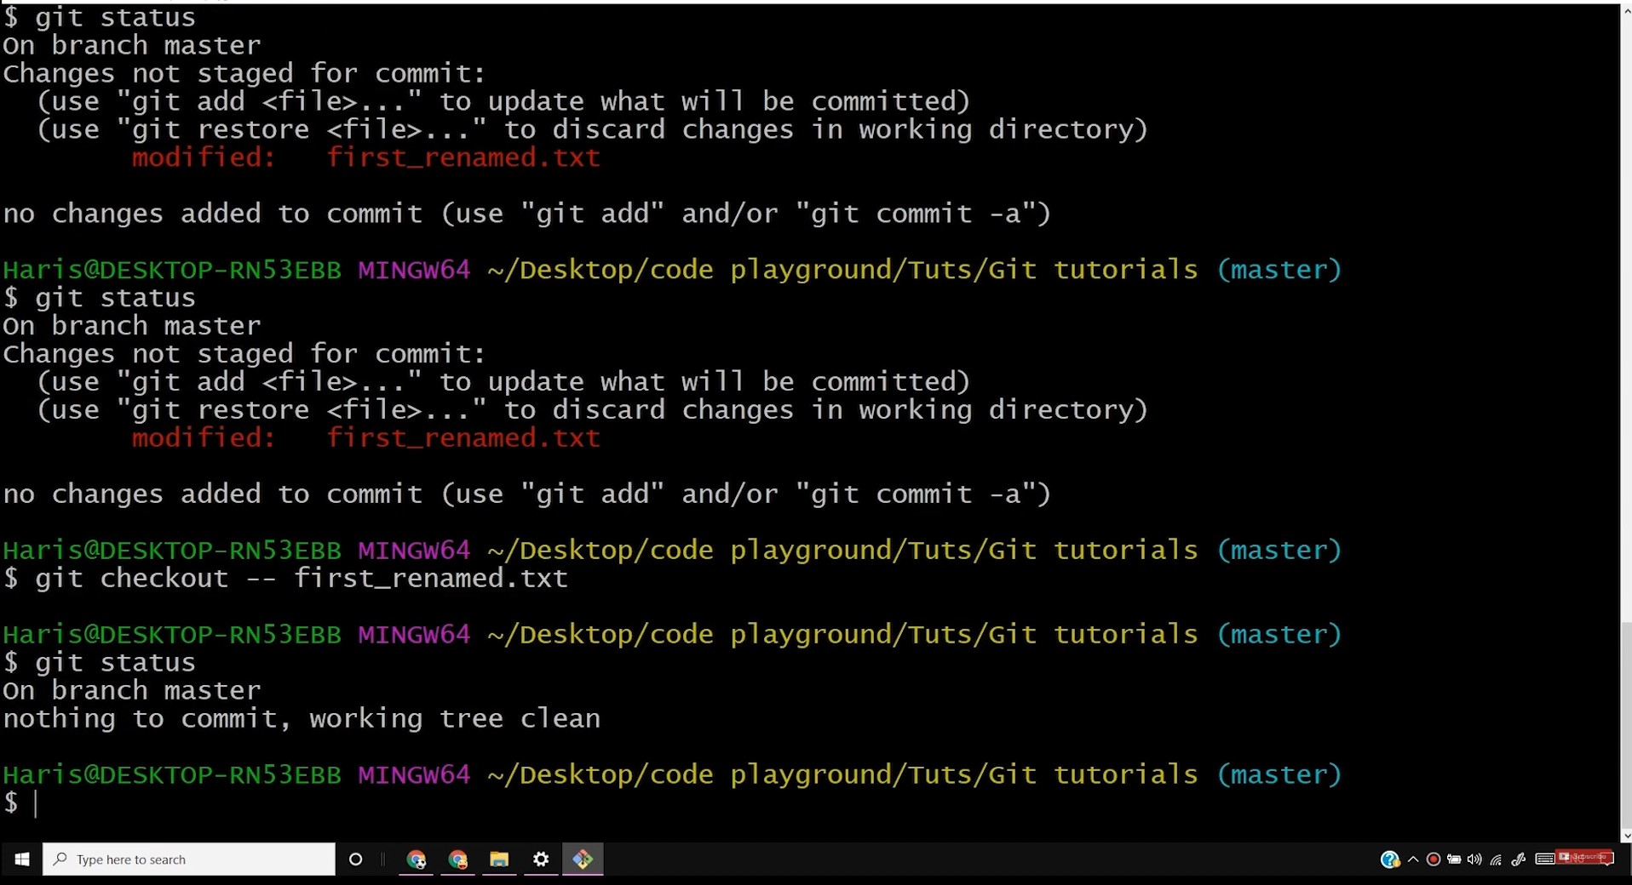
f') MINGW(>4Jcll!ms/H0<i>/[)e,lctop/<00e.playwounO/Tots/Git tuto,ial,
0
X

Slide 50
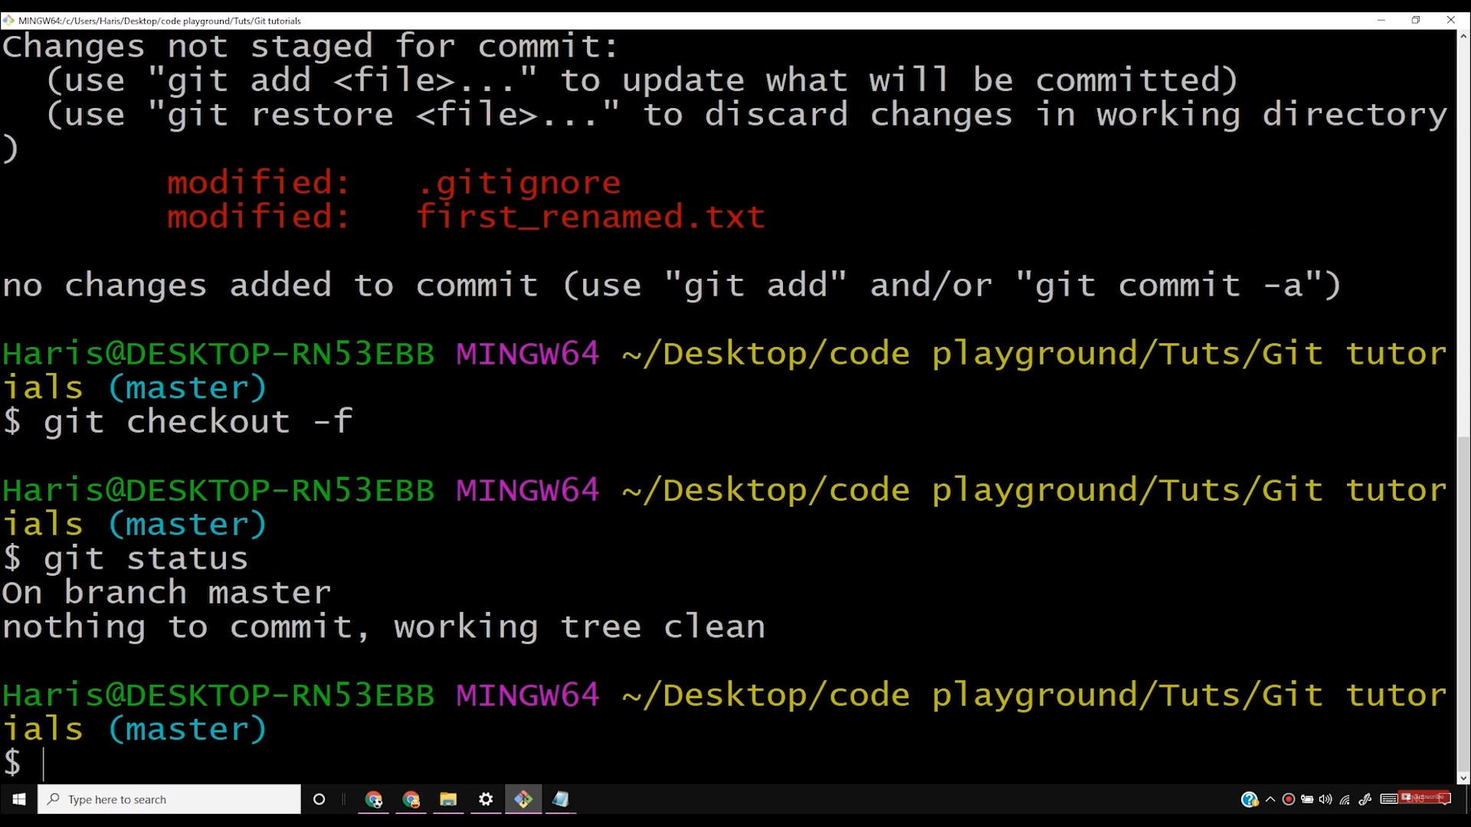

Slide 51
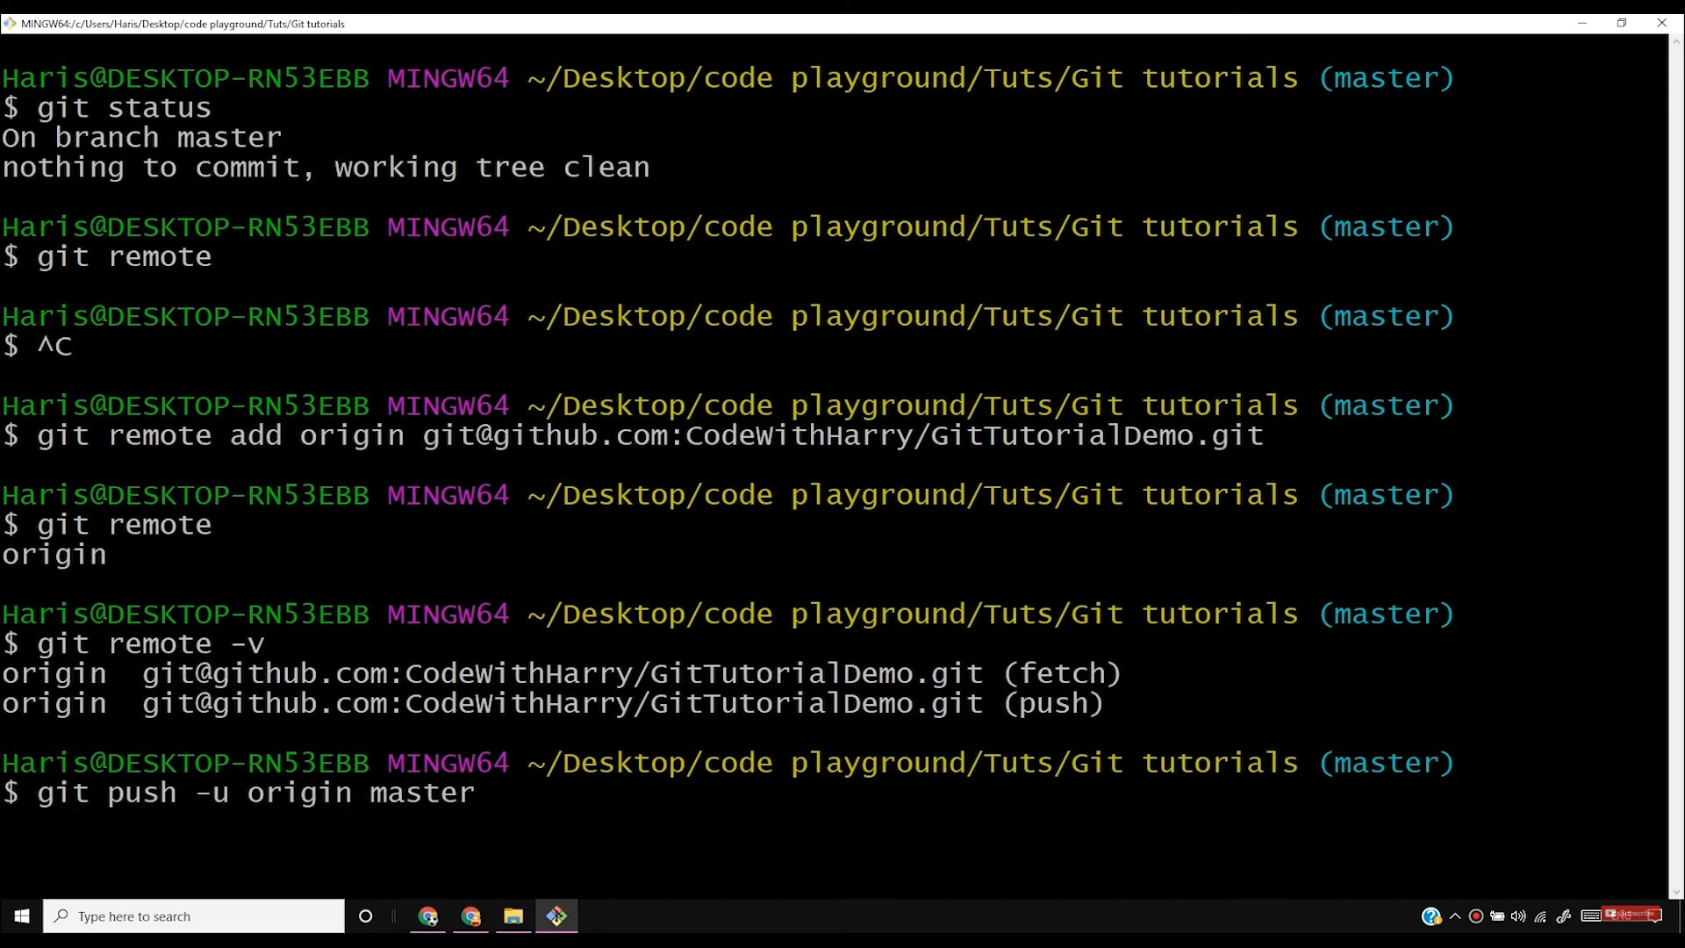

Slide 52
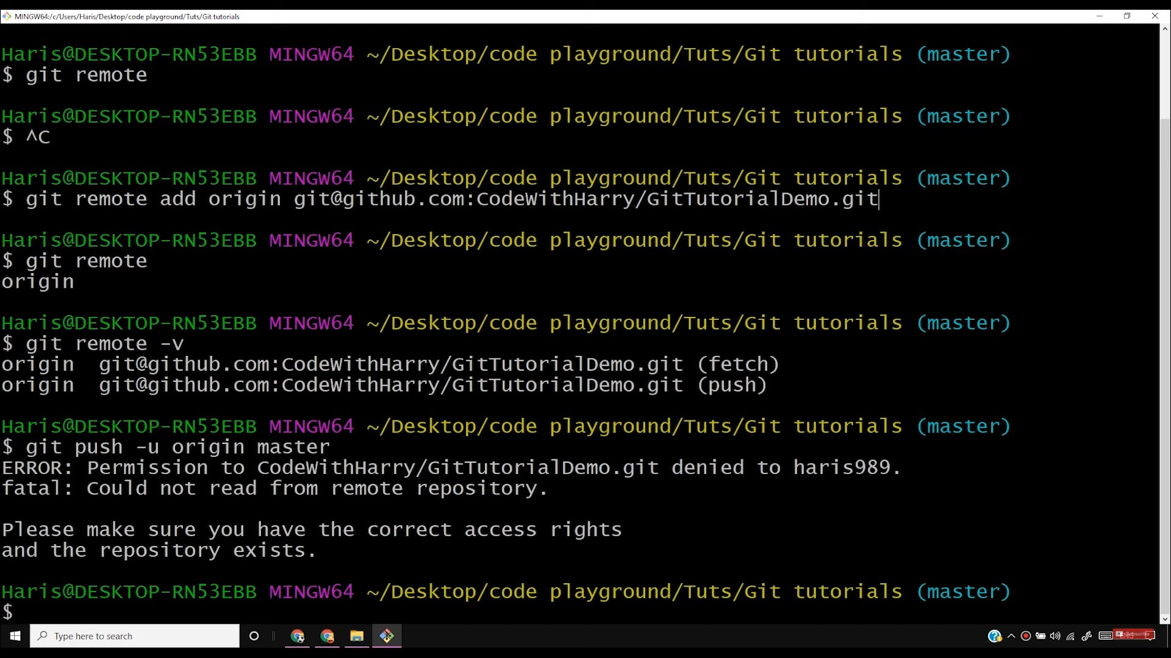

Slide 53
D Complete Grt Tutonals For Beg X O Add new SSH keys X I G ssh keysgrthub • Google Search X O Generating a new SSH key and X
Q help.github.com/en/enterpnse/2.17/user/authent1catm9-to-91thub/generatmg-a-new-ssh-key-and-addmg-1t- to-the-ssh-agent
+
(ll
X
.•• Apps D YouTube M Gma1I
D CodeW1thHarry • Y... D C Language Tutoria... D Programm1n9W1th... D fovaScnpt Tutorials... D Pythontutonals for... D Machine Leaming T... D Android Oevelopm... D Complete G,t Tutori...
the ssh-agent
After you've checked for existing SSH keys, you can generate a new SSH key to use for authentication, then add it to the ssh-agent.
Mac
Windows
All
If you don't already have an SSH key, you must generate a new SSH key. If you're unsure whether you already have an SSH key, check for existing keys.
If you don't want to reenter your passphrase every time you use your SSH key, you can add your key to the SSH agent, which manages your SSH keys and remembers your passphrase.
Generating a new SSH key
Open Git Bash.
2 Paste the text below, substituting in your GitHub Enterprise email address.
$ ssh-keygen -t rsa -b 4096 -c "your_email@example.com"
This creates a new ssh key, using the provided email as a label.
Generating public/private rsa key pair.
3 When you're prompted to "Enter a file in which to save the key," press Enter. This accepts the default file location.
Enter a file in which to save the key (/c/Users/you/.ssh/id_rsa):[Press enter]
4 At the prompt, type a secure passphrase. For more information, see ·working with SSH key passphrases".
Enter passphrase (empty for no passphrase): {Type a passphrase]> Enter same passphr
P Type here to search

Slide 54
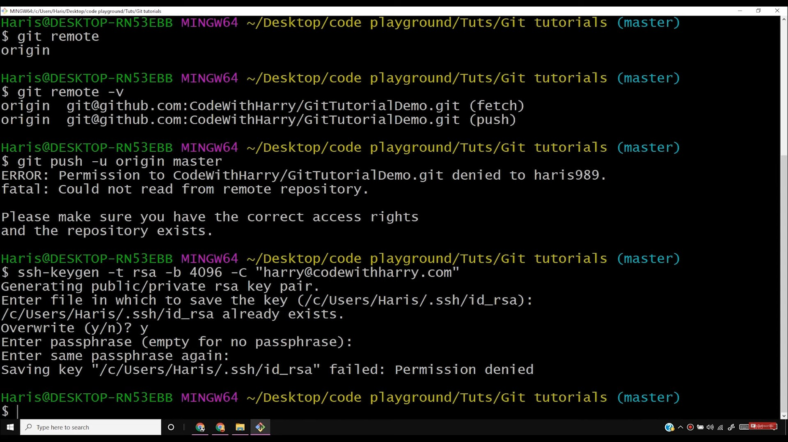

Slide 55
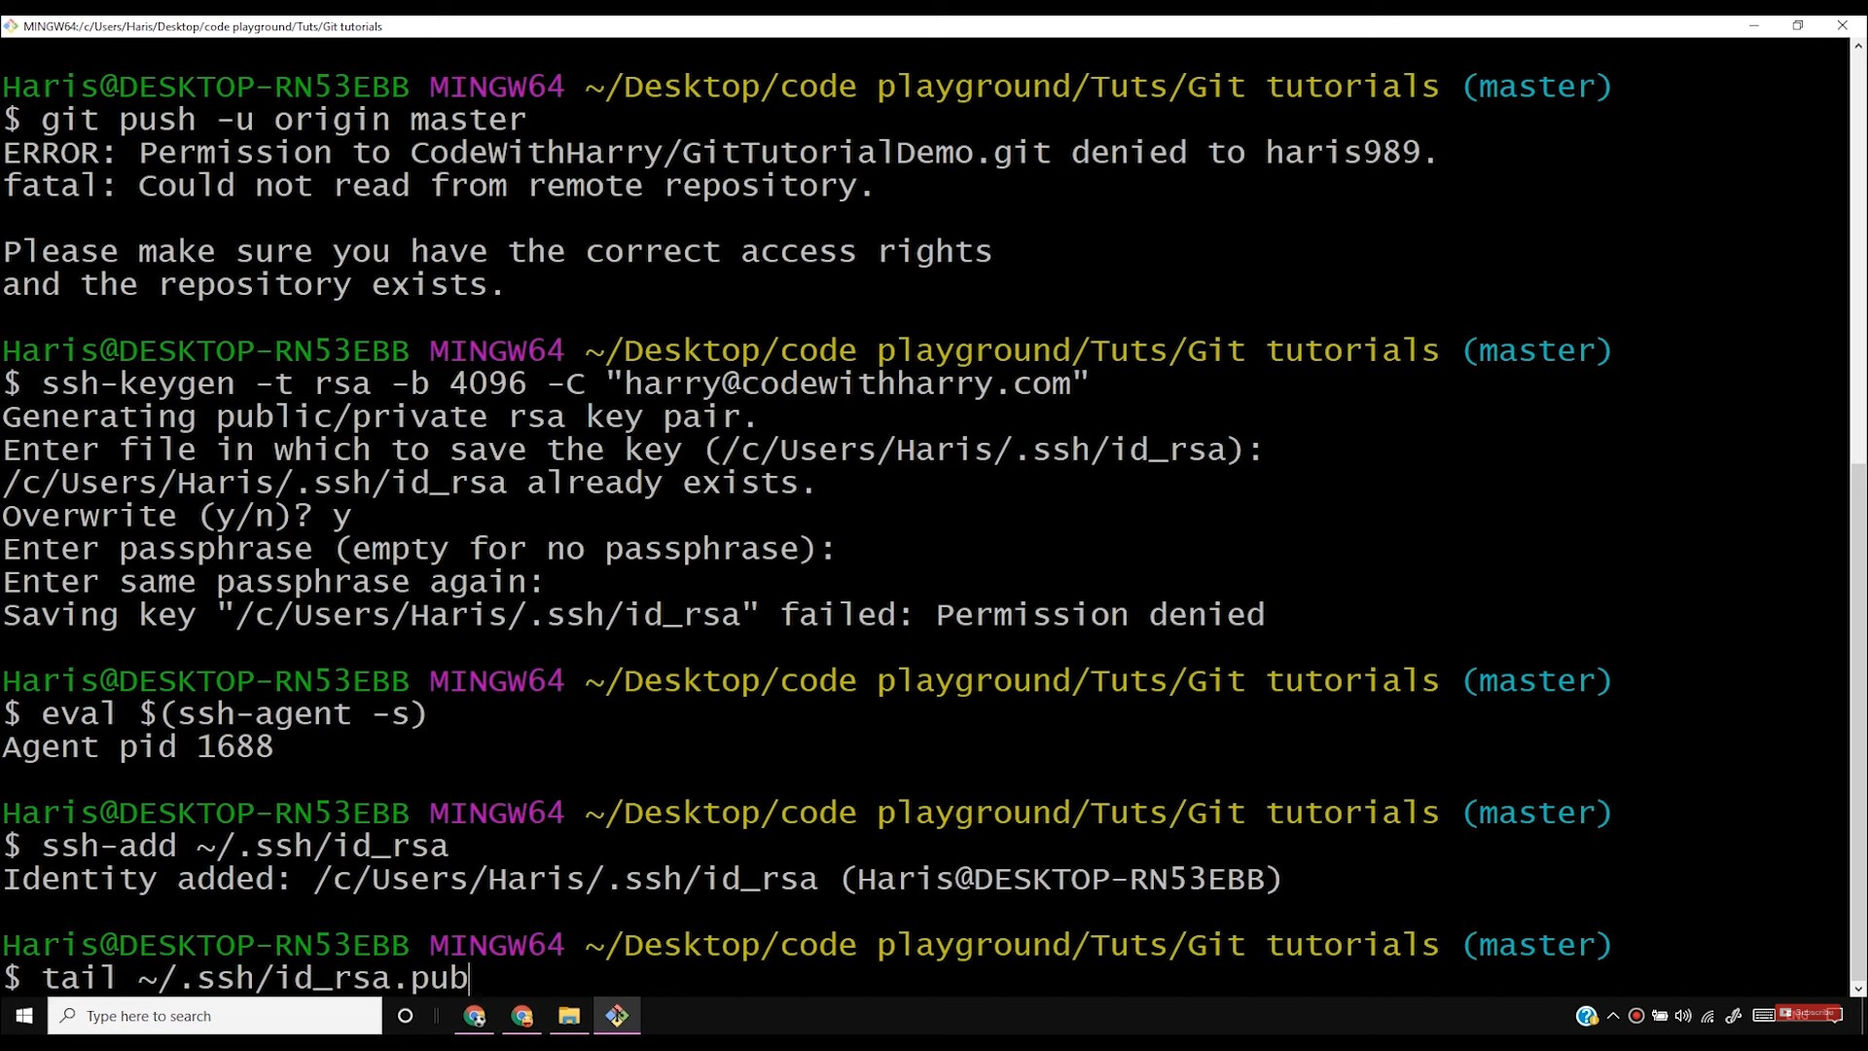

Slide 56


Slide 57


Slide 58


Slide 59

'>MINGW(>4Jc/LJ,.,,JH,.;,J[)e,lctop/<ode.playwounO/T ot,/Git tuto,ial,
0
X

Slide 60


Slide 61


Slide 62


Slide 63




Microsoft Whiteboard
C:
Harry. =
--. ,
CJ
P Type here to search

Slide 64


Slide 65


Slide 66


Slide 67


Slide 68


Slide 69


Slide 70


Slide 71


Slide 72


Slide 73


Slide 74


Slide 75


Slide 76


Slide 77



Microsoft Whiteboard
•
oJ
X
..
:::..i............_{t}t.._..,.,........
Harry.
(�
;\
0:_ \U'-1 -()-
1-,.J 9-J."-,
>ll,J. "'\
( <.A
r--
\ ') Uu,
i
\ /
\
l
P Type here to search

Slide 78






Microsoft Whiteboard
t:il
X
y\uA_7
LY\J,
L4--i }k > c :> l(-htlt;r
f_
- C <--
\@;)<
iif-oJ-J. i /<Lr-t
,t- c..,J
P Type here to search

Slide 79


Microsoft Whiteboard
t:il
X
•
Harry. _
P Type here to search

Slide 80


Slide 81


Slide 82


Slide 83


Slide 84


Slide 85


Slide 86


Slide 87


Slide 88




Microsoft Whiteboard
-
CJ1
X
e Harry. =
T-p₋iG>t>
LoYl₁ R
'j?t'., lo.it_ t
wiK ? ls
---? \viaM .....
c!v4-----
1 eul s,'II\+ j.
- b
1ir l',t
'N f\J-
-
p Type here to search

Slide 89


Microsoft Wh1teboard
t5l X
•
Harry. _
l(ssut\ I
V
\../
P Type here to search

Slide 90
(") SSH andGPGkeys
x O CodeWithMarry/OemoRepos1tory x a Complete Git Tutorials For Beg x ] +
X
C
i github.com/CodeW1thHarry/DemoRepos1tory
* 0
••• Apps D YouTube D CodeW1thHarry Y... D C Language Tutoria... D Programming\Vith... D JavaScript Tutorials...
a Pythontutorials for.., D Machine Leaming T... D Android Oevelopm... D Complete Git Tutori...
M Gmail
g CodeWithHarry / DemoRepository
0 Unwatch •
* Star 0
Settings
<>Code
Issues O
"I Pull requests o
Actions
ProJects o
1 Wik,
Security hl!.Insights
Quick setup - if you've done this kind of thing before
$Set upinDesktop or HTTPS SSH https:/ /github.com/CodeWithHarry/OemoRepository .git
Gesttarted by creating a new file or uploading an existing file. We recommend every repository include a README,LICENSE, and .gitignore.
...or create a new repository on the command line
echo "# OemoRepository" >> README.md
git init
git addREAOl'lE .md
git commit -111"first commit"
git remote add origin https: //git hub.com/Codel-Ji thHarry /DemoReposi tory. git
git push -u originmaster
...or push an existing repository from the command line
f ◄4i4·•M&-·14i4i,Mh•&wtm®•&+1::•@mm;;;m;;w,na+m1,1aw
push -u origin master
...or import code from another repository
You can initialize this repository with code from a Subversion, Mercurial, or TFS project.
Import cod
QProTip! Use the URL for this page when adding GitHub as a remote.
P Type here to search
P
-- --- --- ---
q
0
!:ii
-
!'I
@
,f
"'
'
0 )>))
ft?.
,(!, G2lA ,
<!

Slide 91


Slide 92


Slide 93


Slide 94

'\ MINGW /d/B11>inos;/<odo ploy9round/Tut</Grt tutoriol,
0
X

Slide 95

f') MINGW /d/Bu,inos;/<odo ploy9round/Tut>,/Grt tuloriol,
0
X

Slide 96


Slide 97

0 Branches, CodeWithHany/Oem X D Complete Git Tutorials For 8e9 X I +
til
X
C i github.com/CodeW1thHarry/DemoRepos1to,y/branches
* 0
••• Apps D YouTube M Gmail D CodeW1thHarry • Y.., D C Language Tutori.,... D ProgrammingWith... a JavaScript Tutorials... D Pythontutorials for... D Ma,chine Leaming T...
D Android Oevelopm... D Complete Git Tutori...
0
Why GitHub?
Enterprise
Explore
Marketplace
Pricing
Sign in
IJ CodeWithHarry / DemoRepository
©Watch
* Sta, 0
Yro,k o
<>Code
Issues 0
Pull requests O
i'! Projects 0
Security
lili. Insights
Active
Stale
All branches
Search b anche
Default branch
IN ster Updated 18 days ago by Harry
mll!!I
Active branches
!!Y.ID.!'g
Updated 13 minutes ago by Harry
t.'lCompa,e
bu&fix Updated 13 minutesago by Harry
t.'lCompa,e
© 2019GrtHub, Inc, Terms Privacy Se,curity Status Help
ContactGrtHub Pricing API Training Blog About
https://91thub.com/CodeW1thHany/DemoRepos1tory/tree/mybu9fix
P Type here to search
0
Ri
P
-- --- --- ---
A O ;,) >)) cf•
!I
,f
ft?.
C'Jl
QI
,

Slide 98


Slide 99


